Slide 1
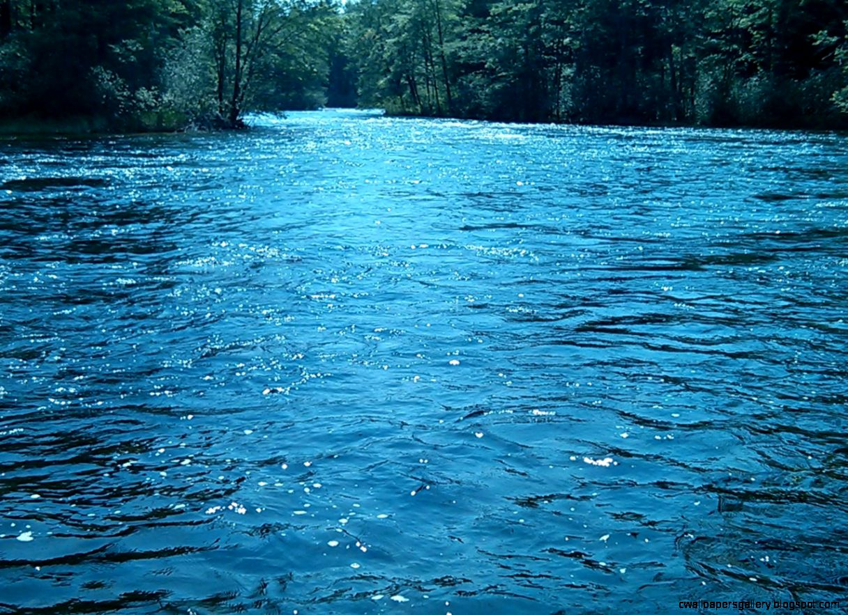

Watershed Surface and Channel Runoff Coefficient Assessment with Unified Runoff Time Implications
2024 National Hydraulic Engineering Conference
Ken Kagy P.E., CFM, CPSWQ, CPESC
AN EVALUATION OF ESTIMATING the TIME of CONCENTRATION to DETERMINE PEAK RUNOFF FLOWS for SMALL WATERSHED BASINS
Notes:
Intro Slide
Top: Add Presentation Title, Bottom: Add Presenter Name(s) (Name, Affiliation)

Slide 2
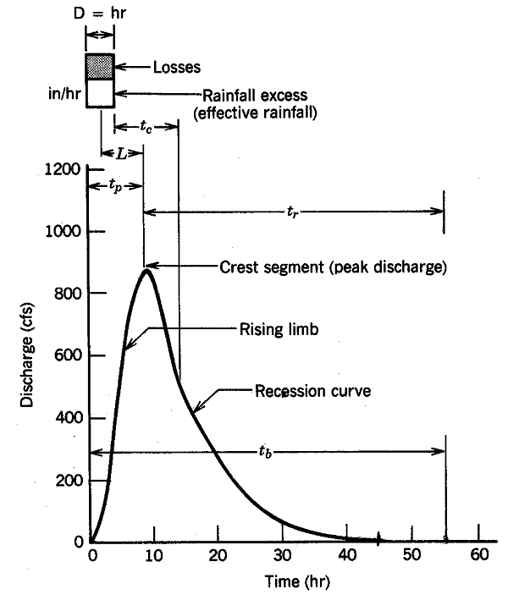
Time of Concentration’s Definition
SCS Method
  Time of Concentration t_{c}: Time required for water to travel from the most hydraulically remote point in the basin to the basin outlet.
This time is determined by drainage characteristics such as surface density, slope, channel roughness, and soil infiltration. Many empirical equations have been developed through watershed research.
Taken from Wanielista, M., R. Kersten, and R. Eaglin, Hydrology: Water Quantity and Quality Control, p. 184

Slide 3
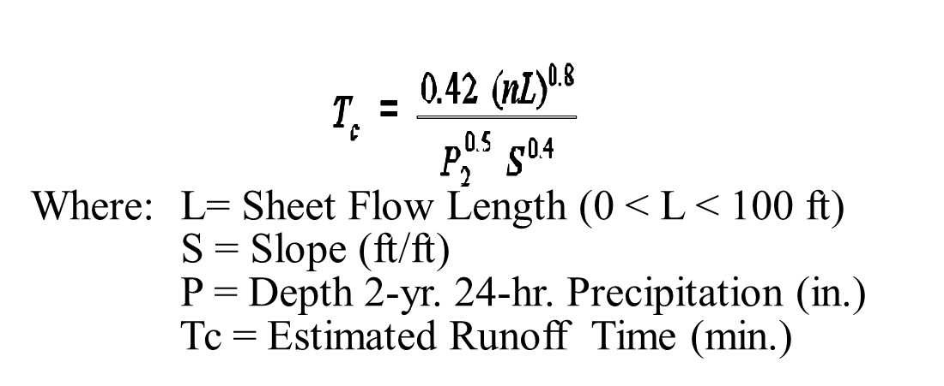
Sheet Flow
Precipitation
Sheet flow
A basin unit flow expressed by an implicit channelized flow
(Used in surface & channel flow)
Infiltration
Sheet Flow
TR-55 Sheet Flow—The sheet flow time computed for each area of sheet flow that requires the following input data:
Hydraulic Length—Defined flow length for the sheet flow.
  Manning's n—Manning's roughness value of the sheet flow.
  Slope— The defined slope of the sheet flow/catchment.
Manning’s Kinematic Wave Eq.

Slide 4
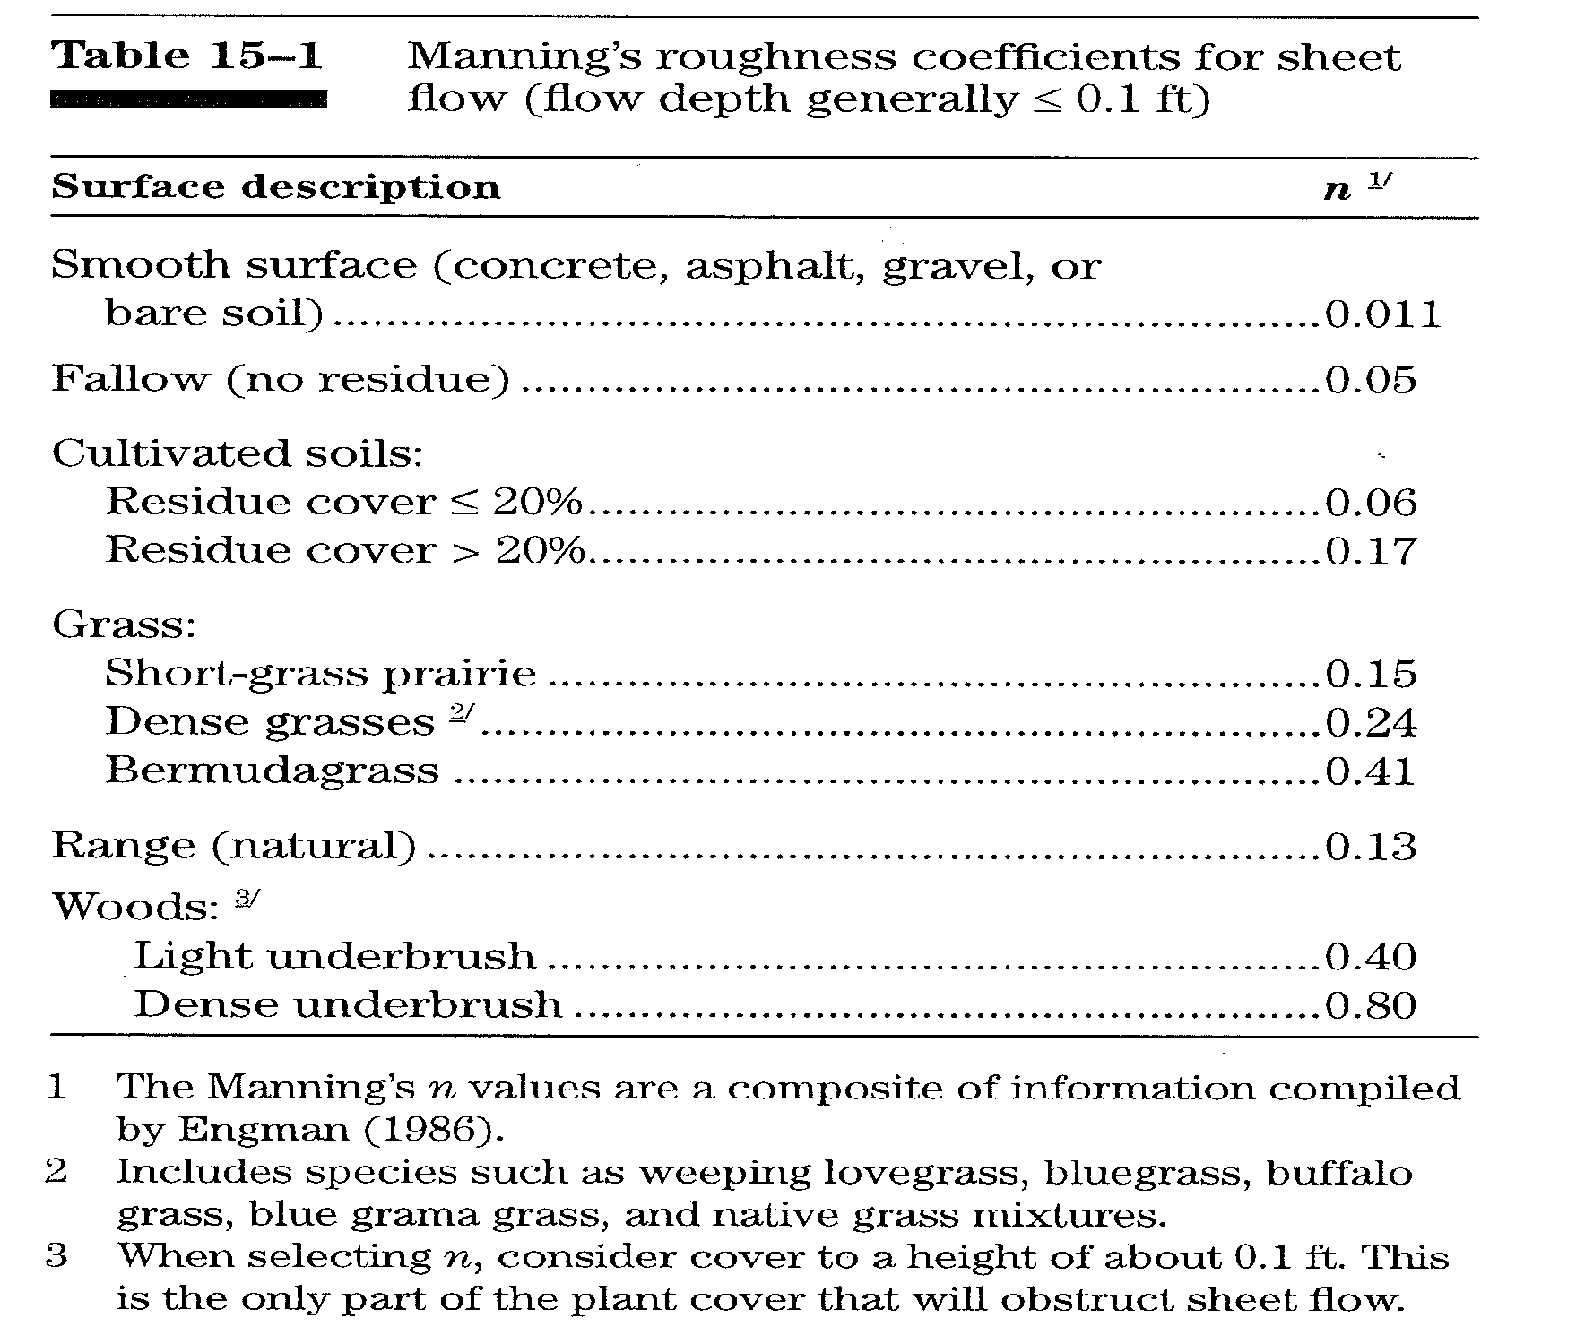

Slide 5

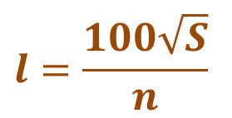
Sheet Flow Limitations
National Engineering Handbook
Kibler and Aron (1982) and others indicated the maximum sheet flow length is less than 100 feet. To support the sheet flow limit of 100 feet, Merkel (2001) reviewed a number of technical papers on sheet flow. McCuen and Spiess (1995) indicated larger sheet flow length variables lead to less accurate designs, and proposed a limitation with equation (15–8) shown below be considered:
$$l=\frac{100\sqrt{S}}{n}$$
Eq. 15-8
where:
n = Manning’s roughness coefficient
l = limiting length of flow (ft)
S = slope (ft/ft)

Slide 6
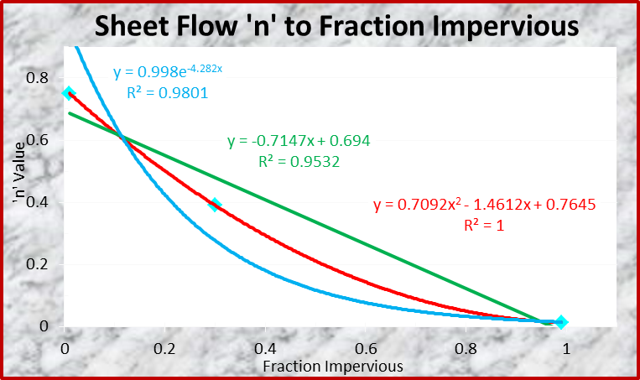
What are ‘n’ Sheet Flow Relationships to Other Surface Runoff Values?
Percent Impervious | Manning’s Low ‘n’ Sheet Flow Values | Manning’s High ‘n’ Sheet Flow Values | Manning’s Average ‘n’ Sheet Flow Values
1% | 0.700 | 0.800 | 0.750
 | 0.450 | 0.550 | 0.500
30% | 0.300 | 0.480 | 0.390
 | 0.160 | 0.420 | 0.290
 | 0.100 | 0.200 | 0.150
 | 0.022 | 0.033 | 0.028
99% | 0.011 | 0.015 | 0.013

Slide 7
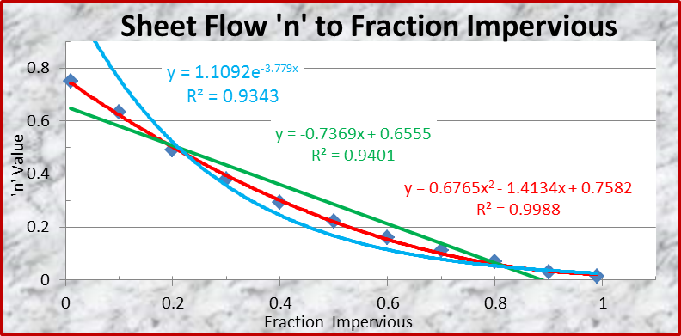
Sheet Flow ‘n’ Coefficient Interpolated to Percent Impervious Surface
Percent Impervious | Exponential ‘n’ Values | Linear ‘n’ Values | Polynomial ‘n’ Values | Average ‘n’ Sheet Flow Values
1% | 0.750 | 0.750 | 0.750 | 0.750
10% | 0.650 | 0.623 | 0.625 | 0.633
20% | 0.424 | 0.551 | 0.501 | 0.492
30% | 0.276 | 0.480 | 0.390 | 0.382
40% | 0.180 | 0.408 | 0.293 | 0.294
50% | 0.117 | 0.337 | 0.211 | 0.222
60% | 0.076 | 0.265 | 0.143 | 0.162
70% | 0.050 | 0.194 | 0.089 | 0.111
80% | 0.032 | 0.122 | 0.049 | 0.068
90% | 0.021 | 0.051 | 0.024 | 0.032
99% | 0.013 | 0.013 | 0.013 | 0.013

Slide 8
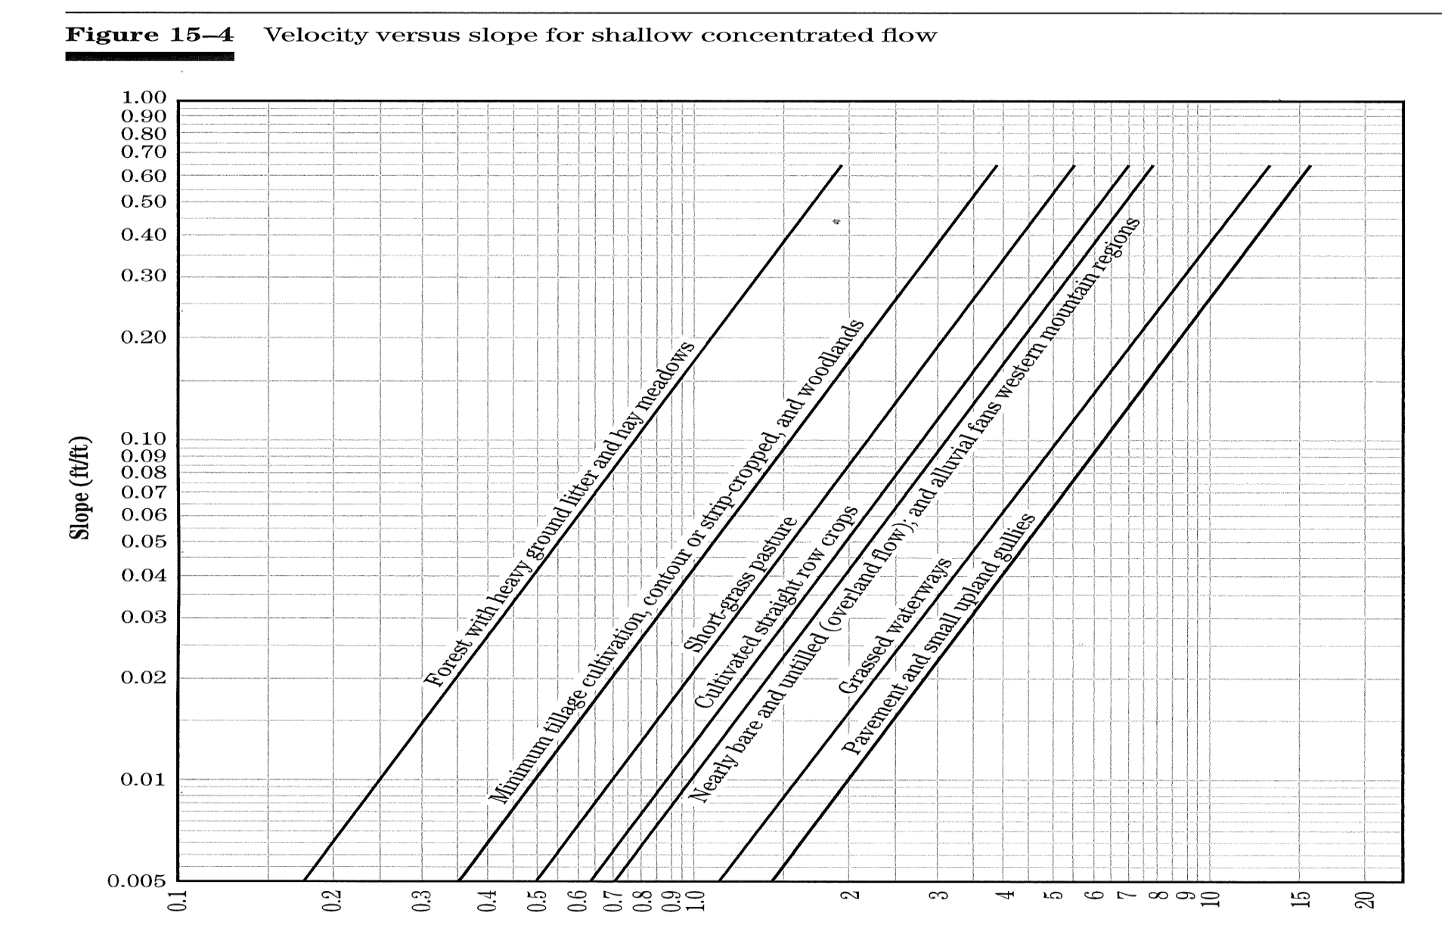
Shallow Concentrated Flow
Channelized Flow Time
Chapter 15 Part 630
of National Engineering Handbook
NRCS definition of shallow flow is 1 inch to 6 inches deep

Slide 9
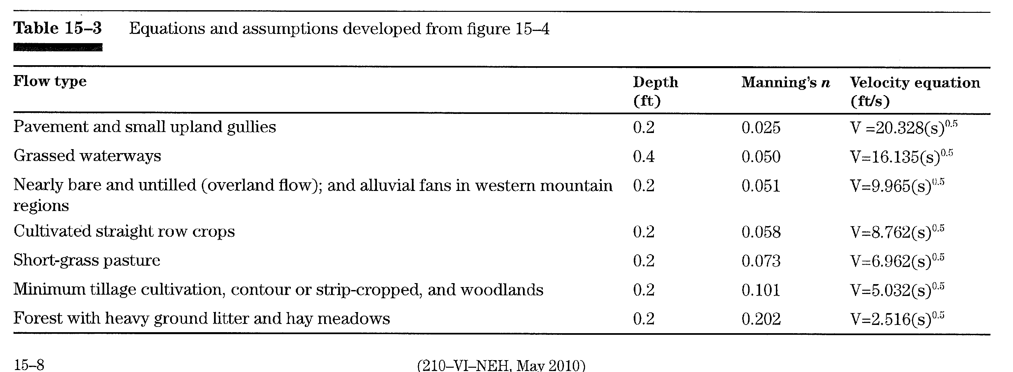
Shallow Flow Equations from NEH, May 2010

Slide 10
Shallow Flow Velocity Equations for 0.25 ft. of Depth and Manning's “n”
Mannings “n” Value | Depth of Flow (ft.) | Velocity Equations (ft./s)
0.200 | 0.25 | V = 2.949(s)^{0.5}
0.160 | 0.25 | V = 3.686(s)^{0.5}
0.130 | 0.25 | V = 4.536(s)^{0.5}
0.110 | 0.25 | V = 5.361(s)^{0.5}
0.086 | 0.25 | V = 6.857(s)^{0.5}
0.067 | 0.25 | V = 8.802(s)^{0.5}
0.052 | 0.25 | V = 11.341(s)^{0.5}
0.039 | 0.25 | V = 15.121(s)^{0.5}
0.029 | 0.25 | V = 20.335(s)^{0.5}
0.022 | 0.25 | V = 26.805(s)^{0.5}
0.013 | 0.25 | V = 45.363(s)^{0.5}

Slide 11
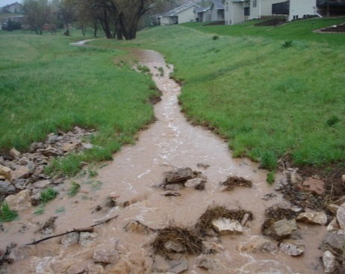
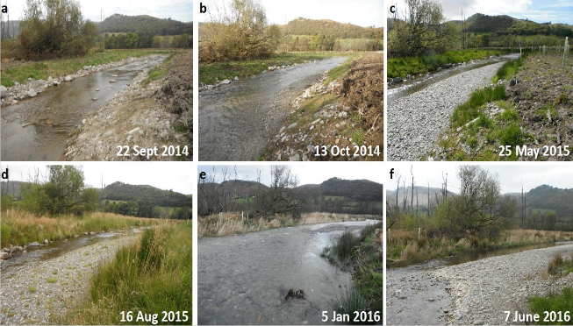
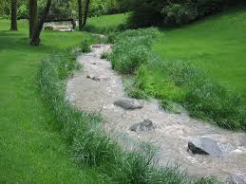
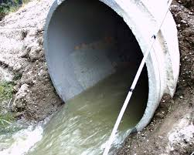
Open Channel Flow Equation
Conveyance Flow for Uniform Geometry
Manning’s Equation
Hydraulic Radius Can Equal Flow Depth in Manning’s Eq. for Small-Wide Channels
T_{c} _{conveyance flow} = Length / Velocity
NRCS’s considers 6 in. or deeper to be channel flow
An initial 8 in. depth is used to initiate channel flows
& increased to 16 in. depth for an average depth of 1 ft.

Slide 12
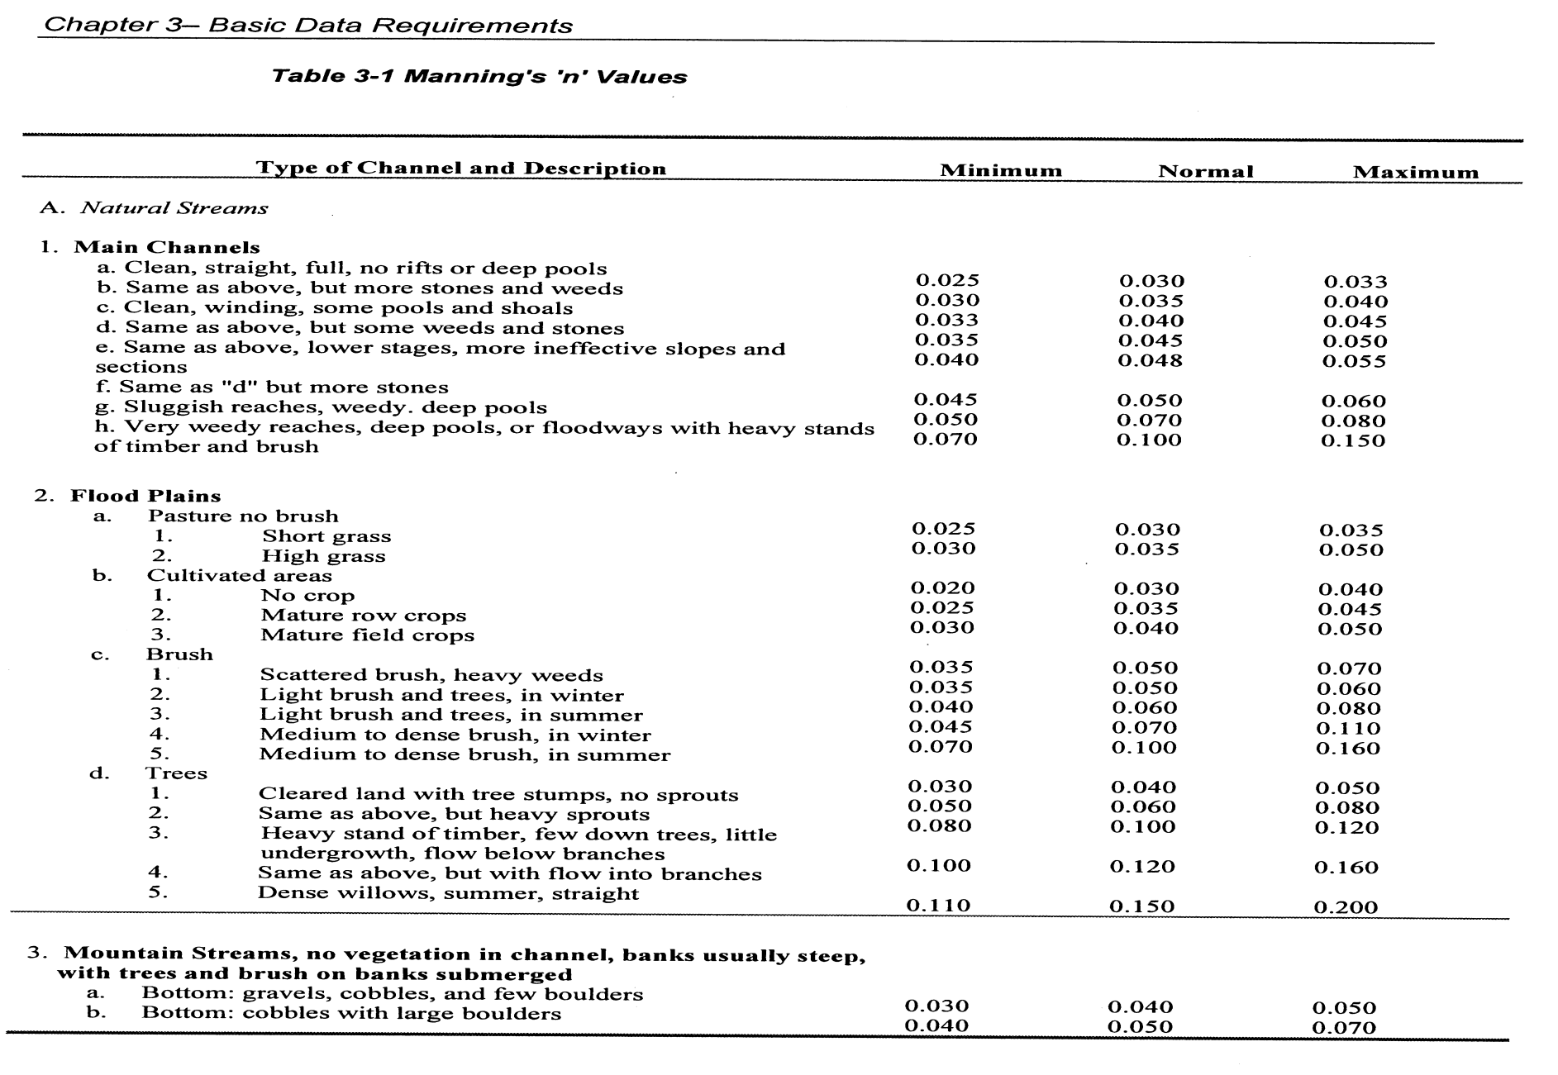
Manning’s ‘n’ Channel Coefficients
From USACE, January 2010, HEC-RAS River Analysis System, Hydraulic Reference Manual, Version 4.1.

Slide 13
Velocity Equations with an 8 to 16 Inch Flow Depth for a Channel “n” Value
Mannings “n” Value | Initial Depth of Flow (ft.) | Velocity Equations (ft./s) | Ending Depth of Flow (ft.) | Velocity Equations (ft./s)
0.140 | 0.67 | V = 8.127(s)^{0.5} | 1.35 | V = 13.157(s)^{0.5}
0.120 | 0.67 | V = 9.482(s)^{0.5} | 1.35 | V = 15.349(s)^{0.5}
0.100 | 0.67 | V = 11.378(s)^{0.5} | 1.35 | V = 18.419(s)^{0.5}
0.085 | 0.67 | V = 13.386(s)^{0.5} | 1.35 | V = 21.670(s)^{0.5}
0.074 | 0.67 | V = 15.376(s)^{0.5} | 1.35 | V = 24.891(s)^{0.5}
0.057 | 0.67 | V = 19.962(s)^{0.5} | 1.35 | V = 32.314(s)^{0.5}
0.042 | 0.67 | V = 27.091(s)^{0.5} | 1.35 | V = 43.855(s)^{0.5}
0.034 | 0.67 | V = 33.465(s)^{0.5} | 1.35 | V = 54.174(s)^{0.5}
0.027 | 0.67 | V = 42.141(s)^{0.5} | 1.35 | V = 68.219(s)^{0.5}
0.021 | 0.67 | V = 54.181(s)^{0.5} | 1.35 | V = 87.711(s)^{0.5}
0.012 | 0.67 | V = 94.817(s)^{0.5} | 1.35 | V = 153.494(s)^{0.5}

Slide 14
Visualizing Tc with Manning’s ‘n’, McCuren & Spiess Limits, & NRCS Velocity Equations
Sheet Flow T_{t} = 0.007(nL)^{0.8}/(P₂^{0.5}S^{0.4})
Shallow Concentrated Flow T_{t} = L /3600V
Open Channel Flow T_{t}= (L*n) /(1.49R^{0.67}S ^{0.5})
(Manning’s Equation)
  Where Hydraulic Radius = conveyance flow depth then:
  Manning’s equation becomes T_{t} = L/3600V
Total Watershed Time of Concentration
t_{c}=ΣT_{t}
  L= ft., T_{t} = hr., S= % slope, R= ft., P= in.(2yr.24hr.) , V= ft./sec.
Sheet flow lengths are 90-110 ft. for 2 & 10% slopes respectively at a full impervious surface
Shallow concentrated flow lengths are 400-500 ft. for 2 & 10% slopes respectively at a full impervious surface
The remaining flow path length is considered channel flow with a comparable Manning’s ‘n’ coefficient to the sheet flow and shallow flow.
The Following Plot is T_{c} Velocity Eq. Boundary:

Slide 15
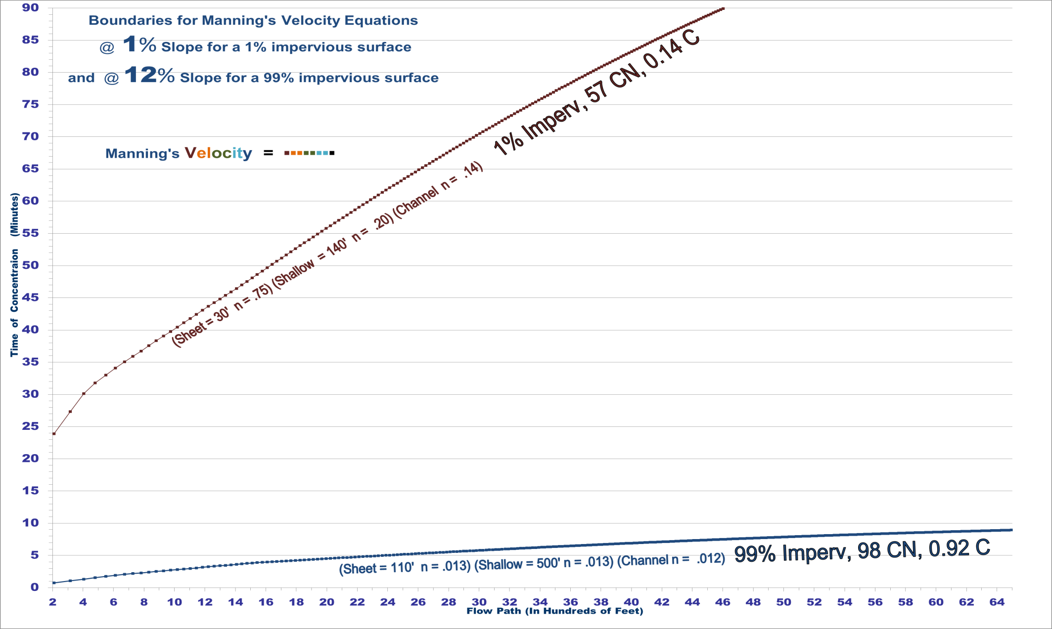
Tc Pervious & Impervious Boundaries for 1% & 12% Basin slopes Respectively
@ 1% Slope
Most T_{c} occurs in this Area
@ 12% Slope

Slide 16
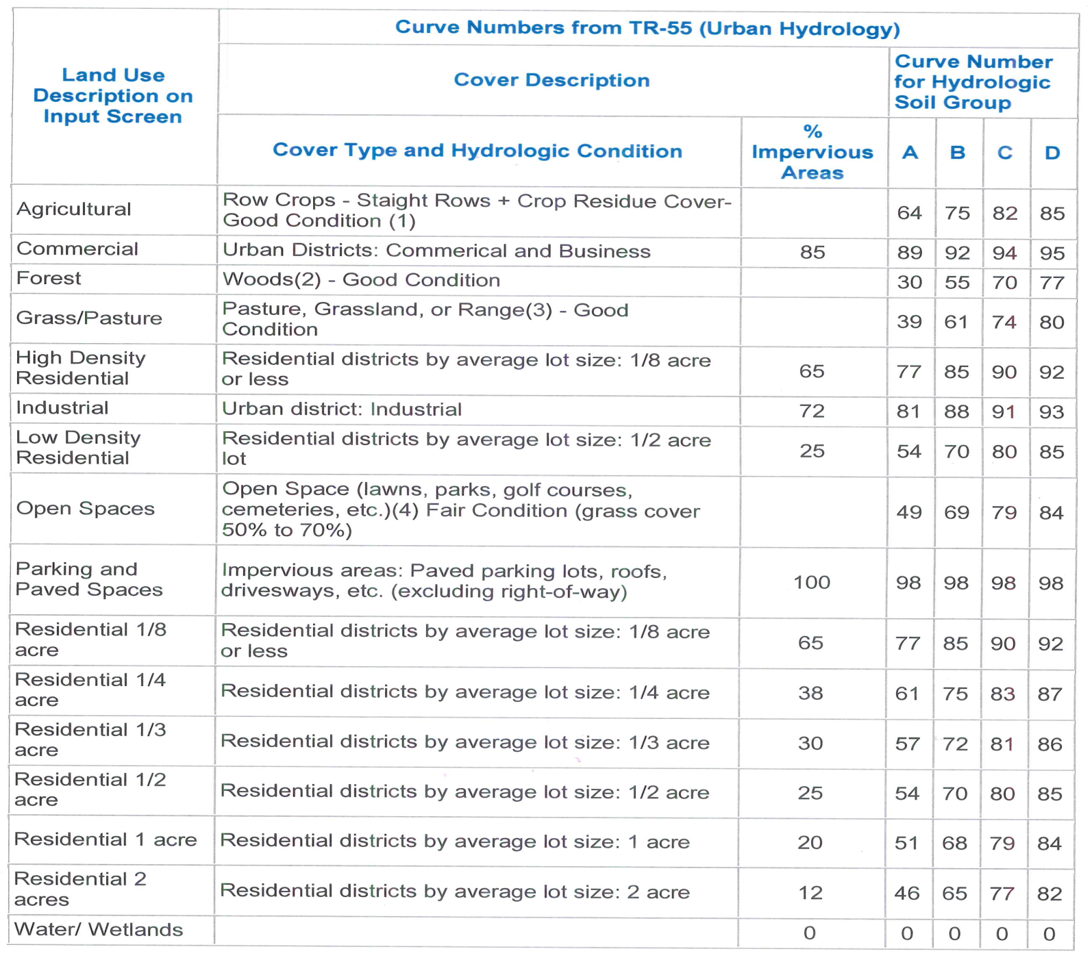
NRCS’s ‘CN’ Values for Soil Groups

Slide 17
Percent Impervious Surface to the Soil Group’s Average ‘CN’ Value
Percent Impervious | Soil Group A | Soil Group B | Soil Group C | Soil Group D | Average ‘CN’ Value for All
1% | 30 | 55 | 70 | 77 | 58.00
12% | 46 | 65 | 77 | 82 | 67.50
20% | 51 | 68 | 79 | 84 | 70.50
25% | 54 | 70 | 80 | 85 | 72.25
30% | 57 | 72 | 81 | 86 | 74.00
38% | 61 | 75 | 83 | 87 | 76.50
65% | 77 | 85 | 90 | 92 | 86.00
72% | 81 | 88 | 91 | 93 | 88.25
85% | 89 | 92 | 94 | 95 | 92.50
99% | 98 | 98 | 98 | 98 | 98.00

Slide 18
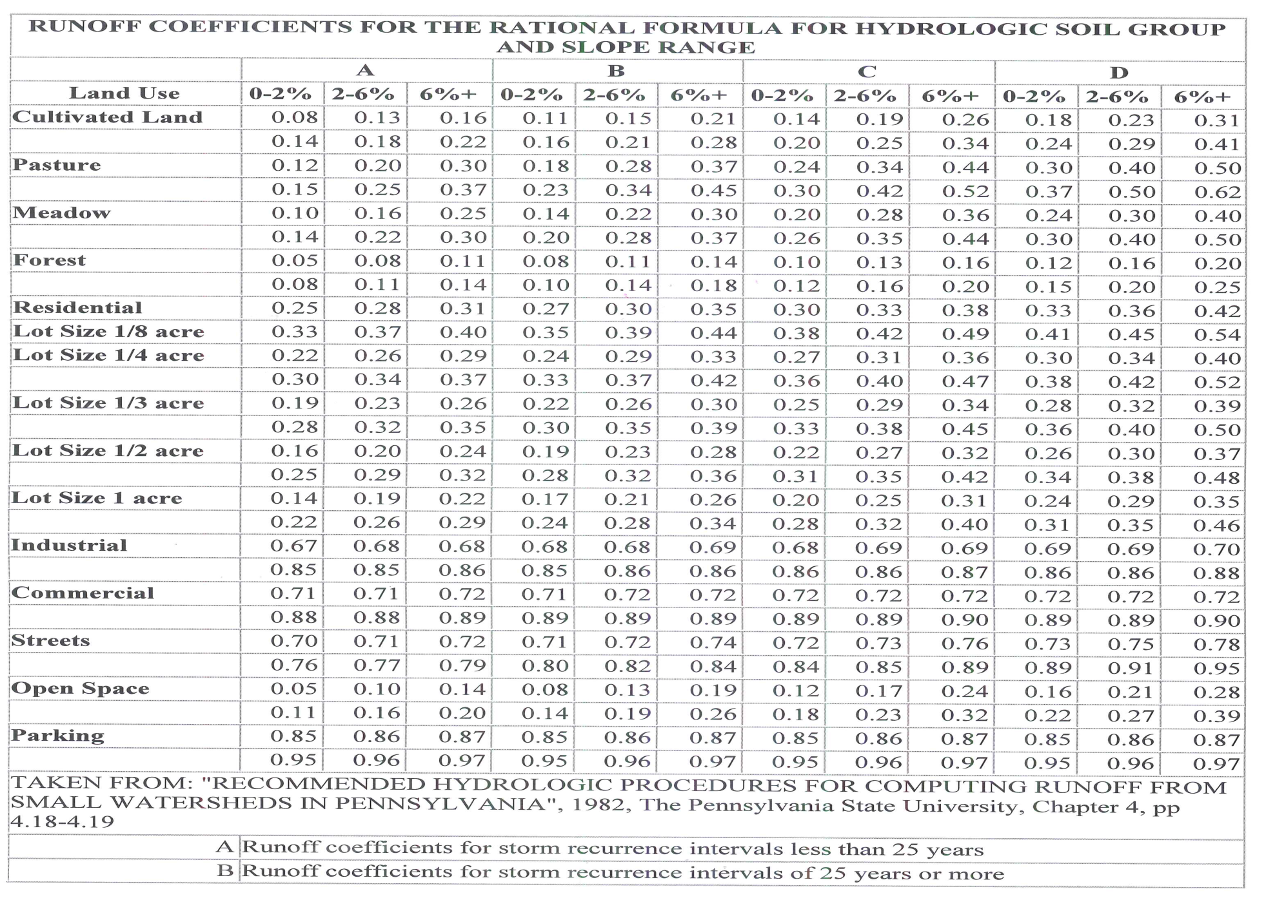
Rational ‘C’ Coefficient with Soil Types

Slide 19
Percent Impervious Surface to the Soil Group’s Average ‘C’ Value
Percent Impervious | Soil Group A | Soil Group B | Soil Group C | Soil Group D | Average ‘C’ Value for All
1% | 0.095 | 0.125 | 0.145 | 0.180 | 0.137
12% | 0.208 | 0.235 | 0.277 | 0.320 | 0.260
20% | 0.225 | 0.245 | 0.285 | 0.320 | 0.269
25% | 0.245 | 0.275 | 0.310 | 0.340 | 0.293
30% | 0.275 | 0.305 | 0.335 | 0.360 | 0.319
38% | 0.300 | 0.330 | 0.355 | 0.380 | 0.341
65% | 0.370 | 0.400 | 0.420 | 0.450 | 0.410
72% | 0.765 | 0.770 | 0.775 | 0.775 | 0.771
85% | 0.795 | 0.805 | 0.805 | 0.805 | 0.803
99% | 0.910 | 0.910 | 0.910 | 0.910 | 0.910

Slide 20
10% Impervious Surface Increments Normalized to ‘CN’ & ‘C’ Coefficients
Percent Impervious | Average ‘n’ Sheet Flow Coefficients | Calculated Average ‘CN’ Value from % | Calculated Average ‘C’ Value from %
1% | 0.750 | 58.0 | 0.14
10% | 0.655 | 63.5 | 0.19
20% | 0.511 | 68.1 | 0.25
30% | 0.395 | 72.6 | 0.31
40% | 0.302 | 76.8 | 0.38
50% | 0.225 | 80.8 | 0.46
60% | 0.161 | 84.6 | 0.54
70% | 0.106 | 88.3 | 0.63
80% | 0.060 | 91.7 | 0.72
90% | 0.021 | 94.9 | 0.82
99% | 0.013 | 98.0 | 0.91
These Values are Plotted in the Following Graphs:

Slide 21
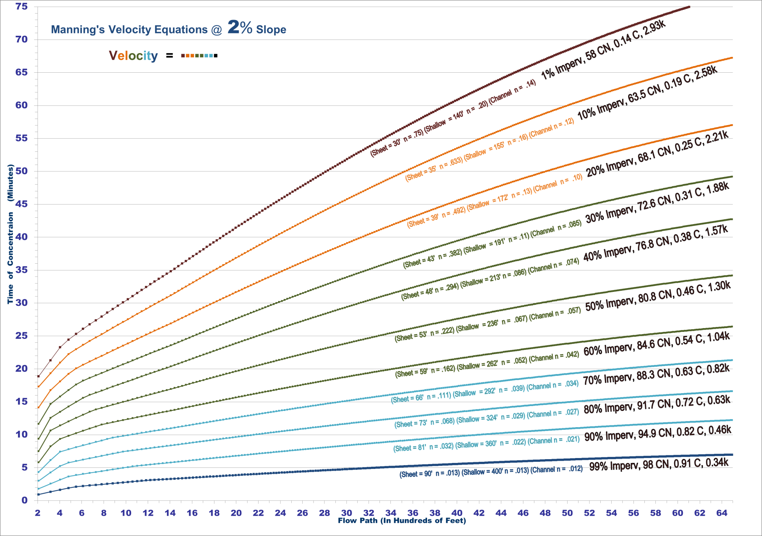
Flow Path vs. T_{c} for 2% slope path

Slide 22
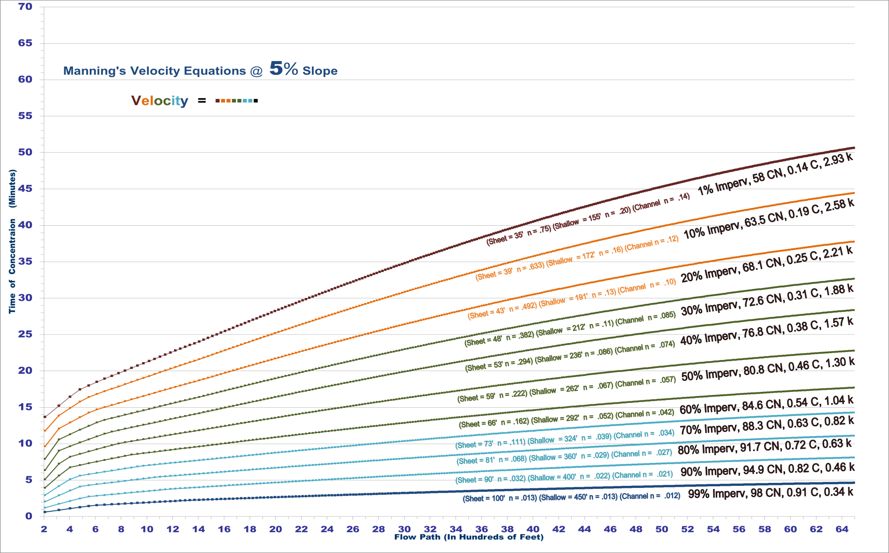
Flow Path vs. T_{c} for 5% slope path

Slide 23
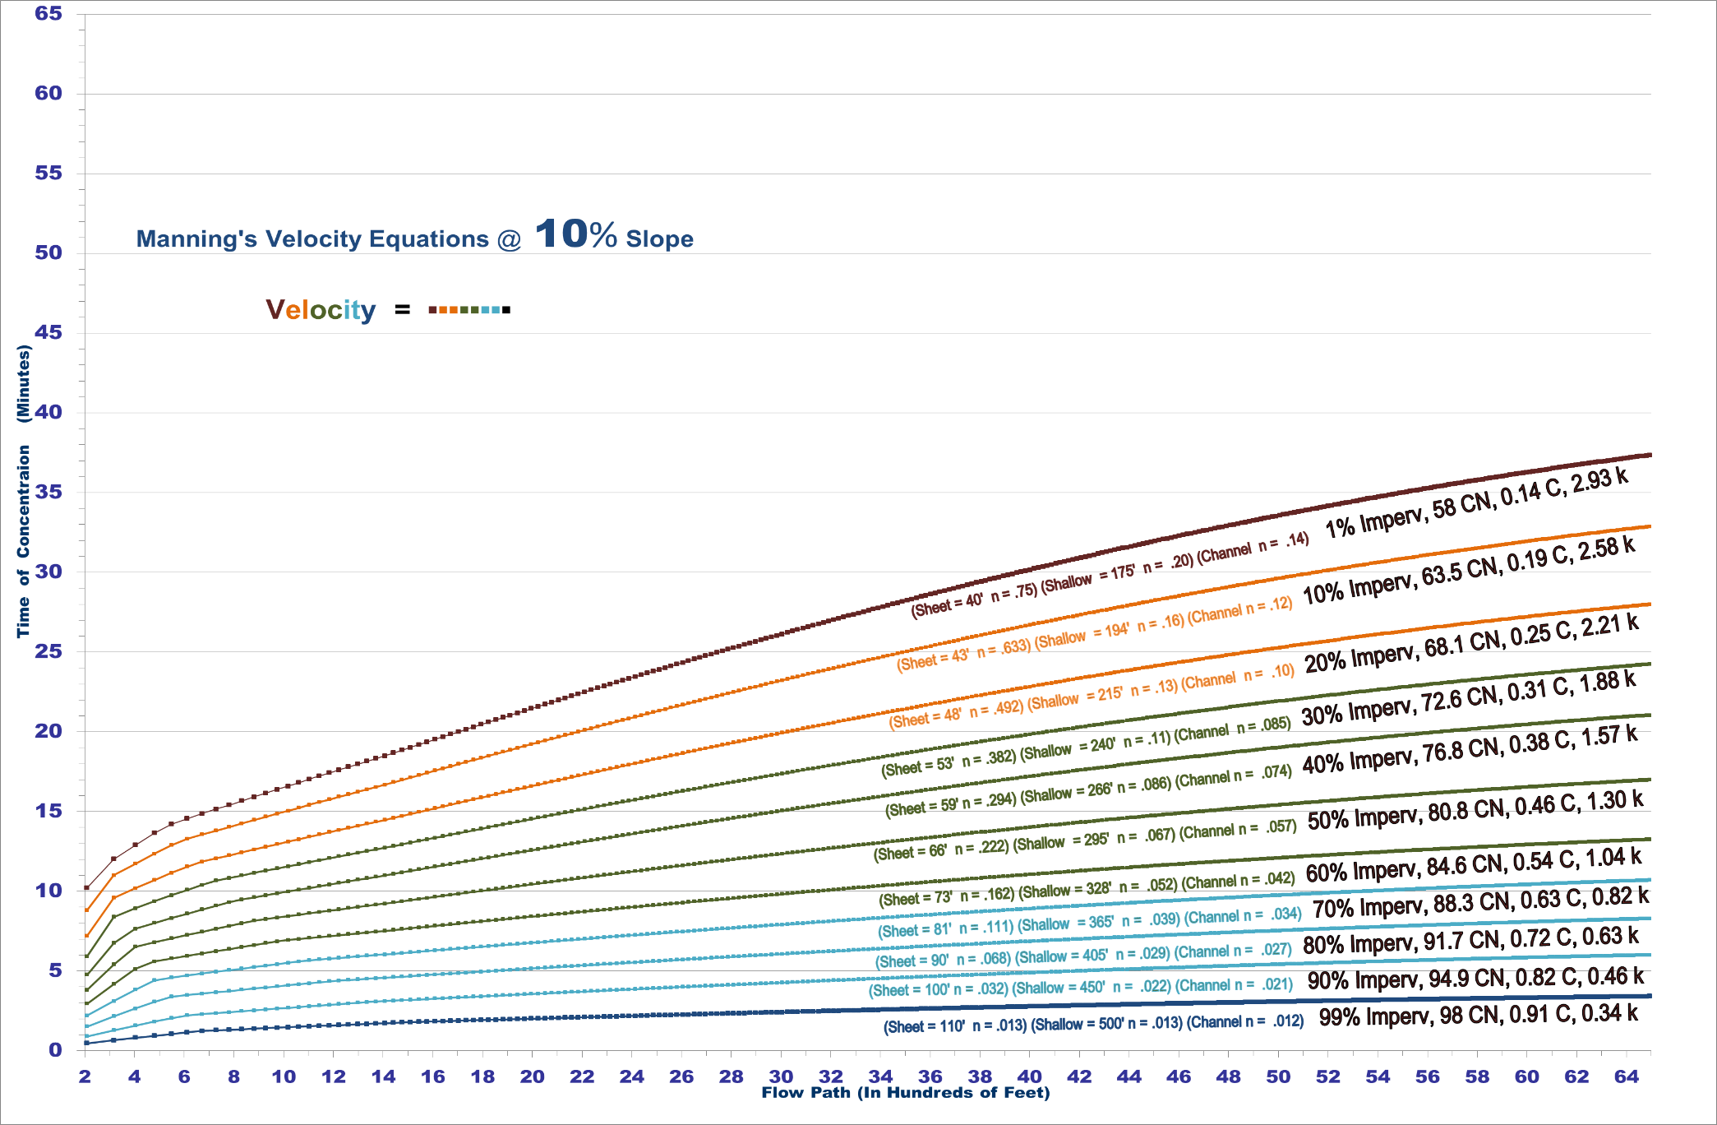
Flow Path vs. Tc for 10% slope path

Slide 24
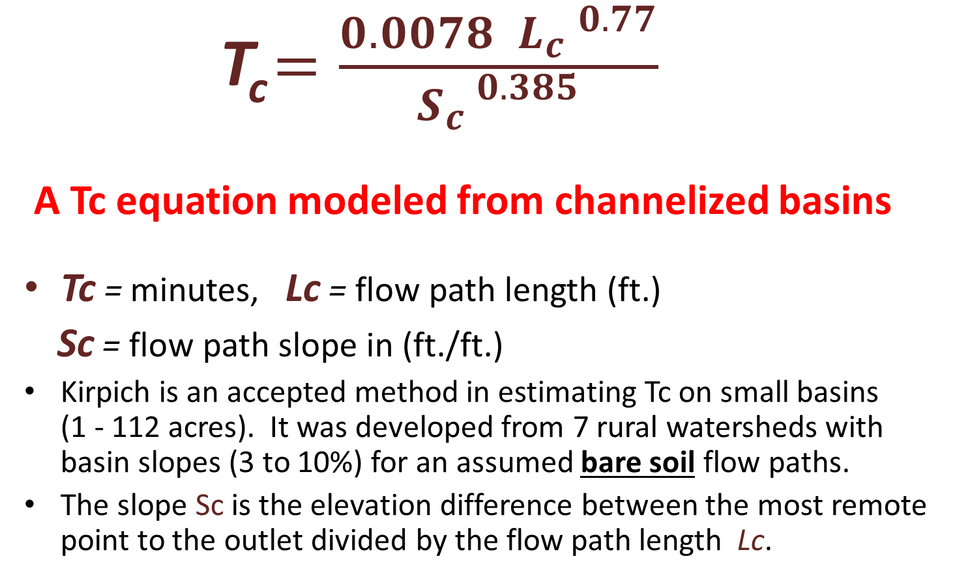
Kirpich Tc Equation
      T_{c} $=\frac{0.0078 { L_{c} }^{0.77}}{{S_{c }}^{0.385}}$
      A Tc equation modeled from channelized basins
Tc = minutes, Lc = flow path length (ft.)
Sc = flow path slope in (ft./ft.)
Kirpich is an accepted method in estimating Tc on small basins (1 - 112 acres). It was developed from 7 rural watersheds with basin slopes (3 to 10%) for an assumed bare soil flow paths.
The slope Sc is the elevation difference between the most remote point to the outlet divided by the flow path length Lc.

Slide 25
Comparisons of Kirpich Equation Factors to other Runoff Coefficients
Ground Cover | Kirpich Adjustment Factor, ‘k’ (Chow, 1988; Chin, 2000)
General overland flow and natural grass channels | 2.0
Overland flow on bare soil or roadside ditches | 1.0
Overland flow on concrete or asphalt surfaces | 0.4
Flow in concrete channels | 0.2

Slide 26
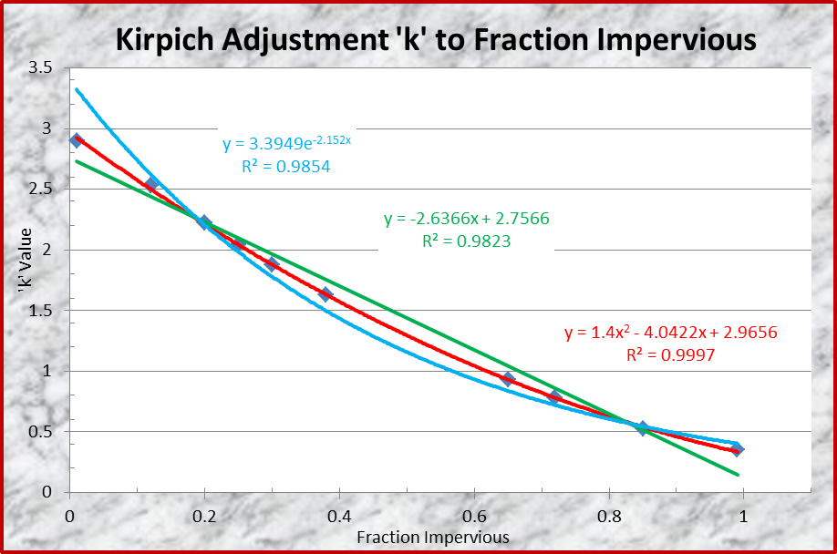
Extrapolated ‘k’ Factor for Maximum Projected 2.9 ‘k’ & minimum 0.35 ‘k’
Basin’s Percent Impervious | Kirpich ‘k’ Adjustment factor
1% | 2.93
10% | 2.58
20% | 2.21
30% | 1.88
40% | 1.57
50% | 1.30
60% | 1.04
70% | 0.82
80% | 0.63
90% | 0.46
99% | 0.34

Slide 27
Average ‘CN’, ‘C’, ‘k’, & ‘n’ Coefficients Normalized to 10% Impervious Surface
Percent Impervious | Calculated ‘CN’ Values from % | Calculated ‘C’ Values from % | Kirpich ‘k’ Values from % | ‘n’ Sheet Flow Coefficients
1% | 58.0 | 0.14 | 2.93 | 0.750
10% | 63.5 | 0.19 | 2.58 | 0.655
20% | 68.1 | 0.25 | 2.21 | 0.511
30% | 72.6 | 0.31 | 1.88 | 0.395
40% | 76.8 | 0.38 | 1.57 | 0.302
50% | 80.8 | 0.46 | 1.30 | 0.225
60% | 84.6 | 0.54 | 1.04 | 0.161
70% | 88.3 | 0.63 | 0.82 | 0.106
80% | 91.7 | 0.72 | 0.63 | 0.060
90% | 94.9 | 0.82 | 0.46 | 0.021
99% | 98.0 | 0.91 | 0.34 | 0.013

Slide 28
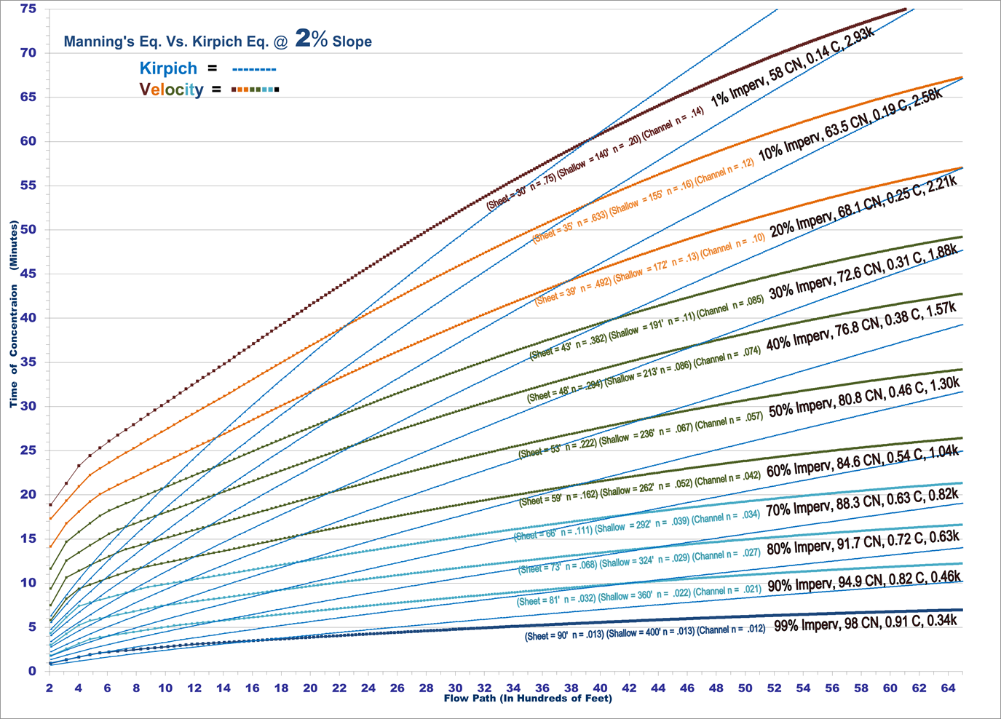
Kirpich & Velocity Eq. Tc’s Compared

Slide 29
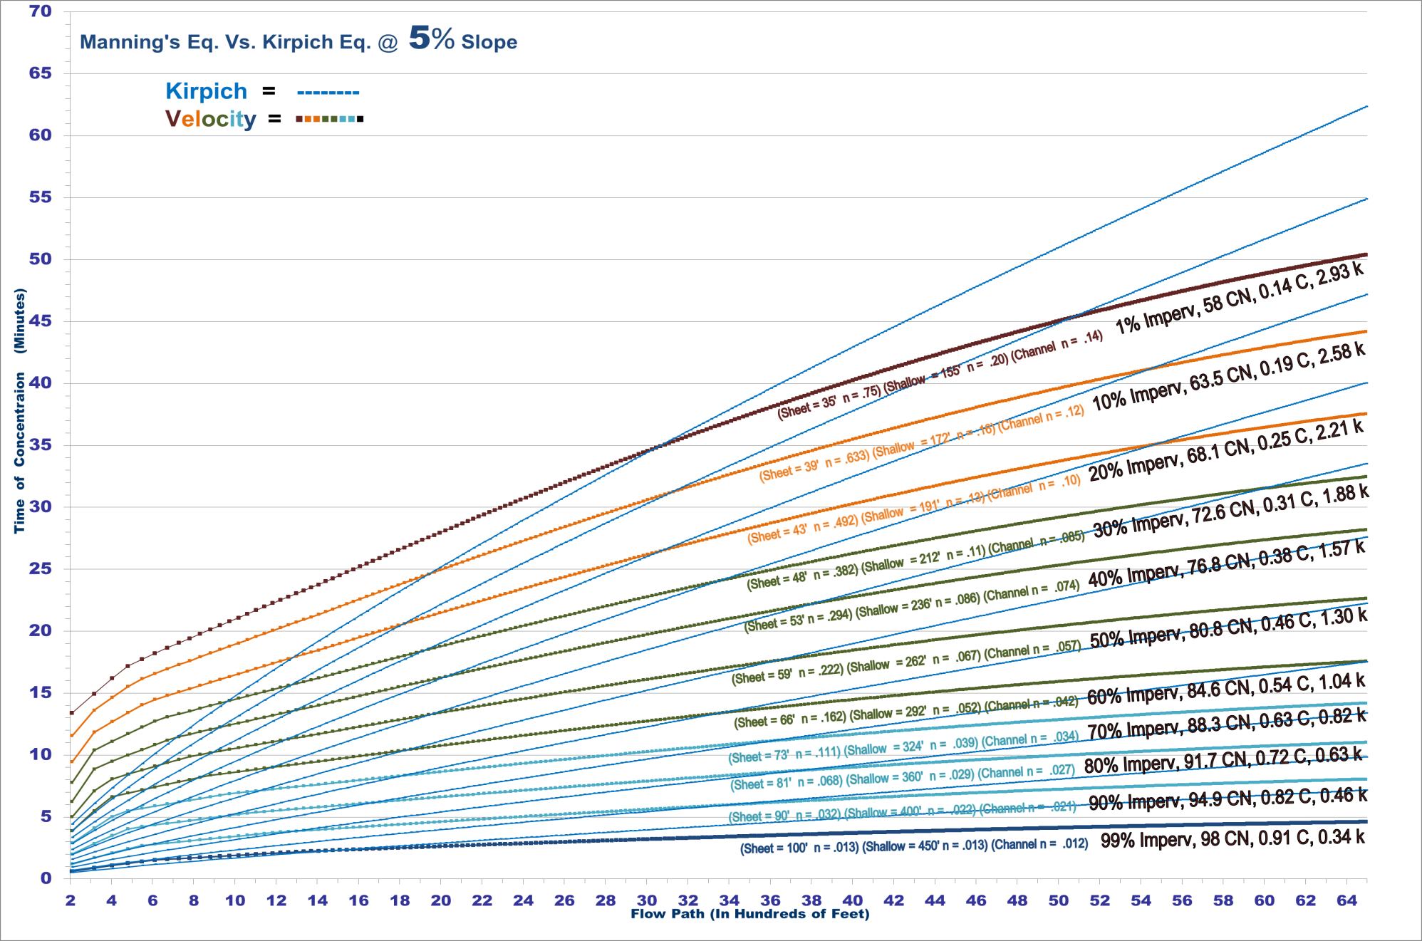
Kirpich & Velocity Eq. Tc’s Compared

Slide 30
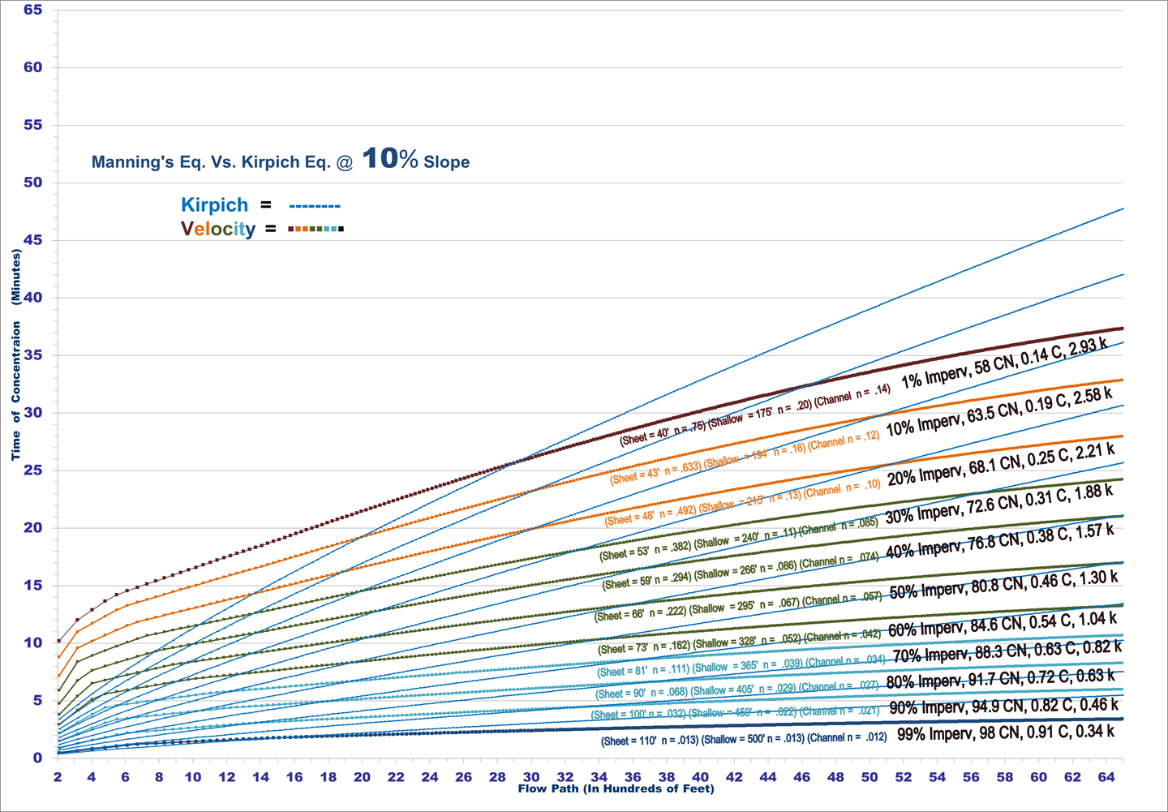
Kirpich & Velocity Eq. Tc’s Compared

Slide 31
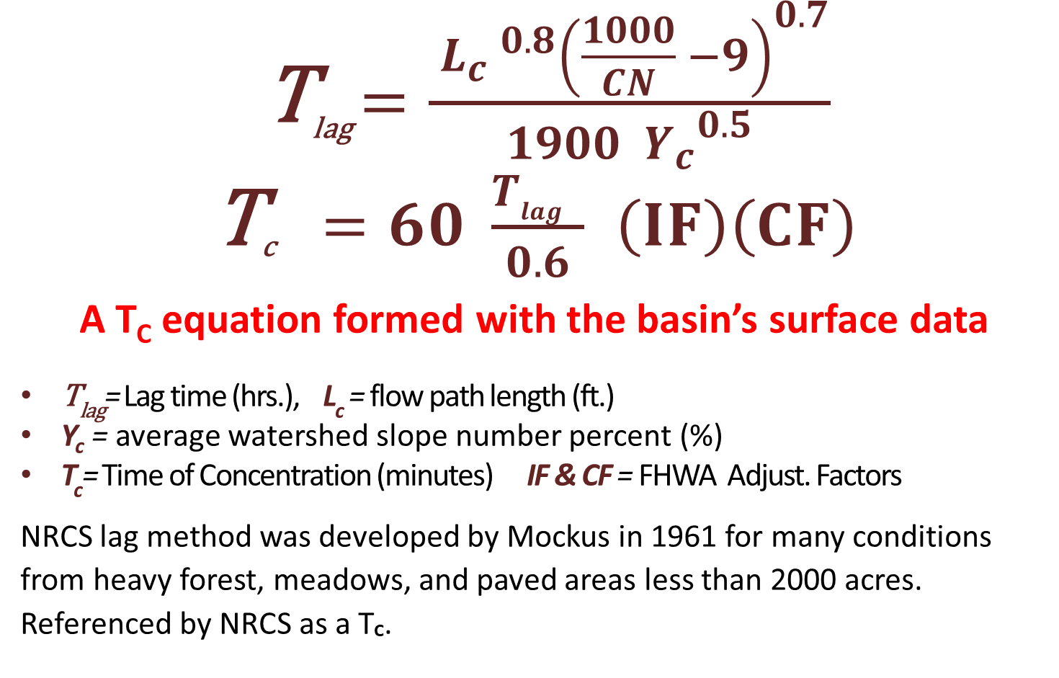
NRCS’s LAG Equation
      T_{lag} $=\frac{{{ L_{c} }^{0.8}\left(\frac{1000}{CN} −9\right)}^{0.7}}{1900{{ Y}_{c}}^{0.5}}$
      T_{c}$=60 \frac{T_{lag} }{0.6}$ $\left(IF\right)\left(CF\right)$
      A T_{c} equation formed with the basin’s surface data
T_{lag}= Lag time (hrs.), L_{c} = flow path length (ft.)
Y_{c} = average watershed slope number percent (%)
T_{c}= Time of Concentration (minutes) IF & CF = FHWA Adjust. Factors
NRCS lag method was developed by Mockus in 1961 for many conditions from heavy forest, meadows, and paved areas less than 2000 acres. Referenced by NRCS as a T_{C}.

Slide 32
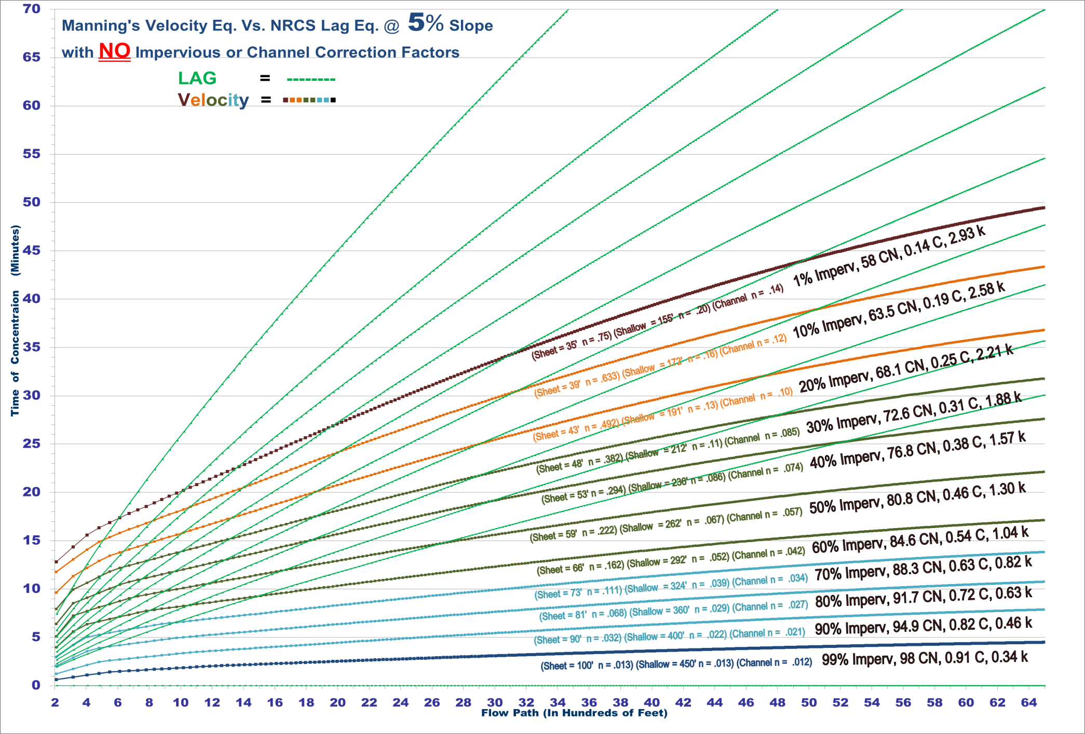
NRCS Lag & Velocity Tc’s Compared

Slide 33
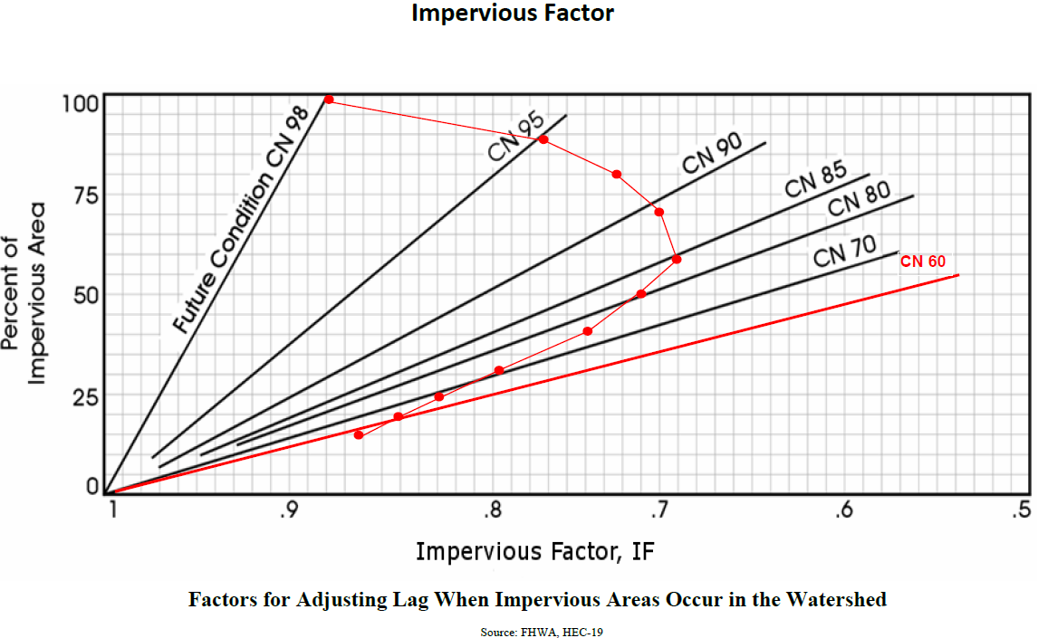
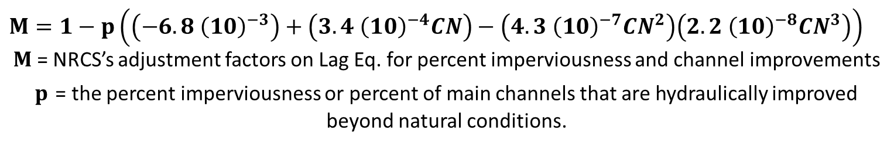
FHWA (HEC19) Adjustment Factors for NRCS Lag Eq. on imperviousness & channel improvements
$$M=1−p\left(\left(−6.8{ \left(10\right)}^{−3}\right)+\left(3.4{ \left(10\right)}^{−4}CN\right)−\left(4.3{ \left(10\right)}^{−7}{CN}^{2}\right)\left(2.2{ \left(10\right)}^{−8}{CN}^{3}\right)\right)$$
$M$ = NRCS’s adjustment factors on Lag Eq. for percent imperviousness and channel improvements
$p$ = the percent imperviousness or percent of main channels that are hydraulically improved beyond natural conditions.

Slide 34
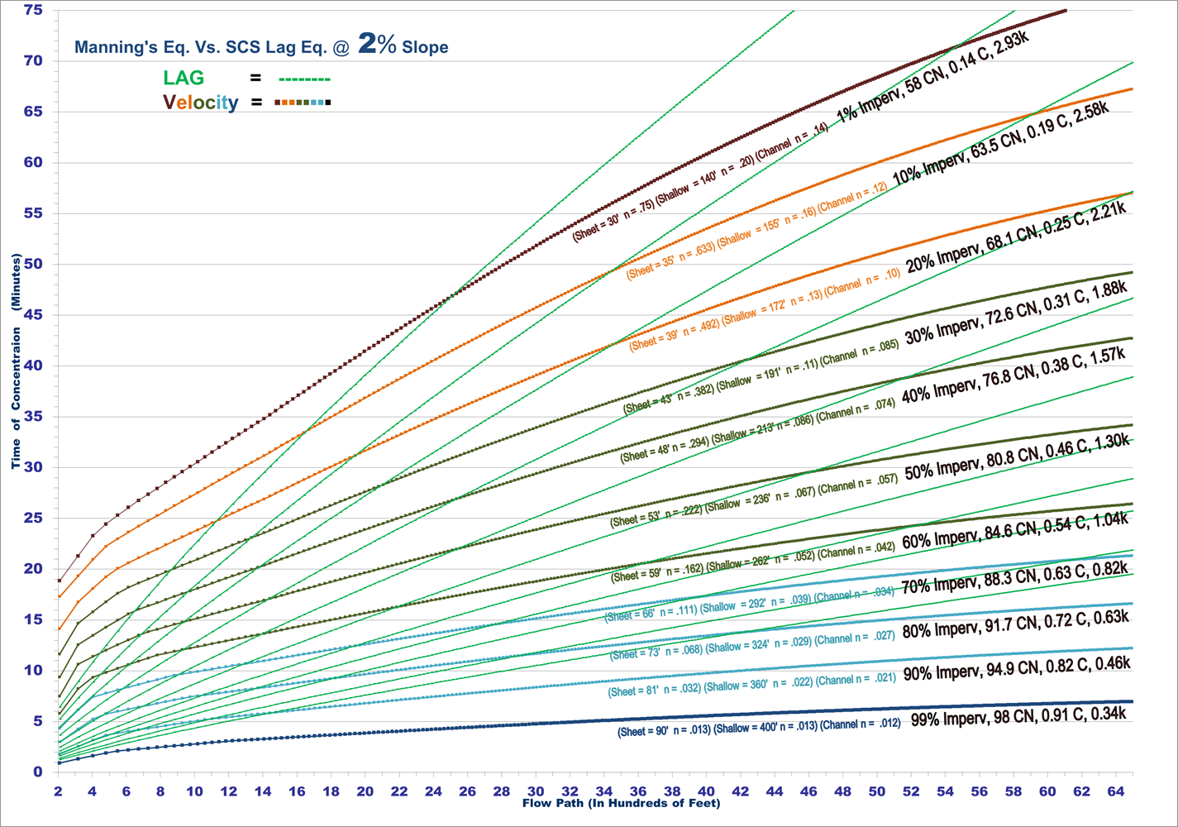
Lag Imp. & Channel Factors vs. Velocity

Slide 35
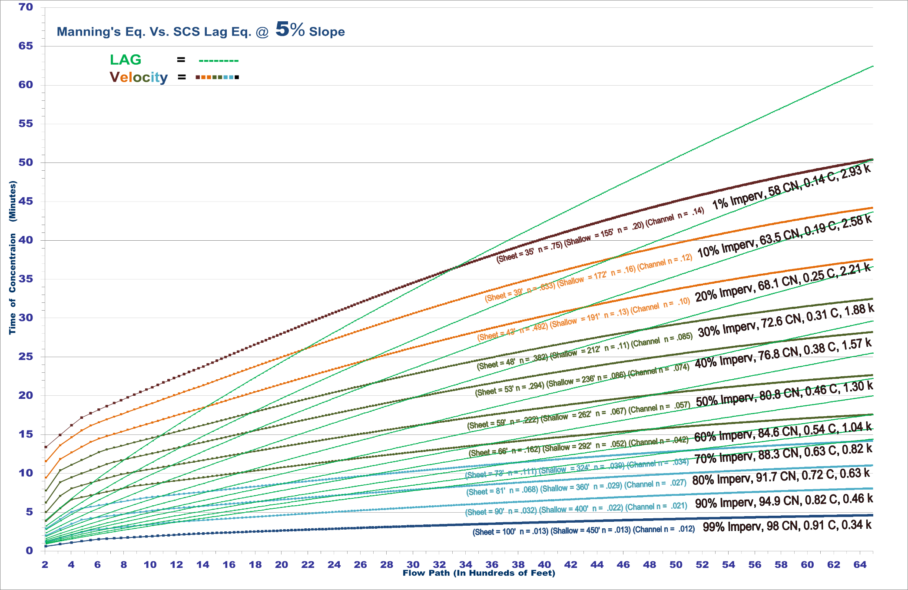
Lag Imp. & Channel Factors vs. Velocity

Slide 36
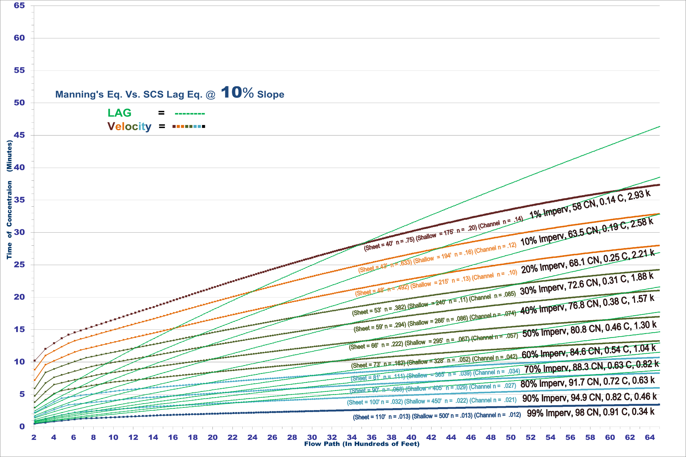
Lag Imp. & Channel Factors vs. Velocity

Slide 37
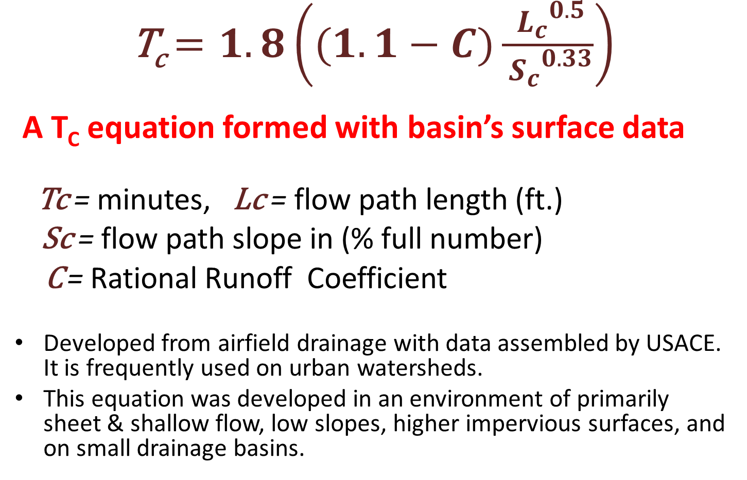
FAA’s T_{c} Equation
      T_{c} $=1.8\left((1.1−C)\frac{{ L_{c}}^{0.5}}{{{ S}_{c}}^{0.33}}\right)$
      A T_{c} equation formed with basin’s surface data
Tc = minutes, Lc = flow path length (ft.)
Sc = flow path slope in (% full number)
C = Rational Runoff Coefficient
Developed from airfield drainage with data assembled by USACE. It is frequently used on urban watersheds.
This equation was developed in an environment of primarily sheet & shallow flow, low slopes, higher impervious surfaces, and on small drainage basins.

Slide 38
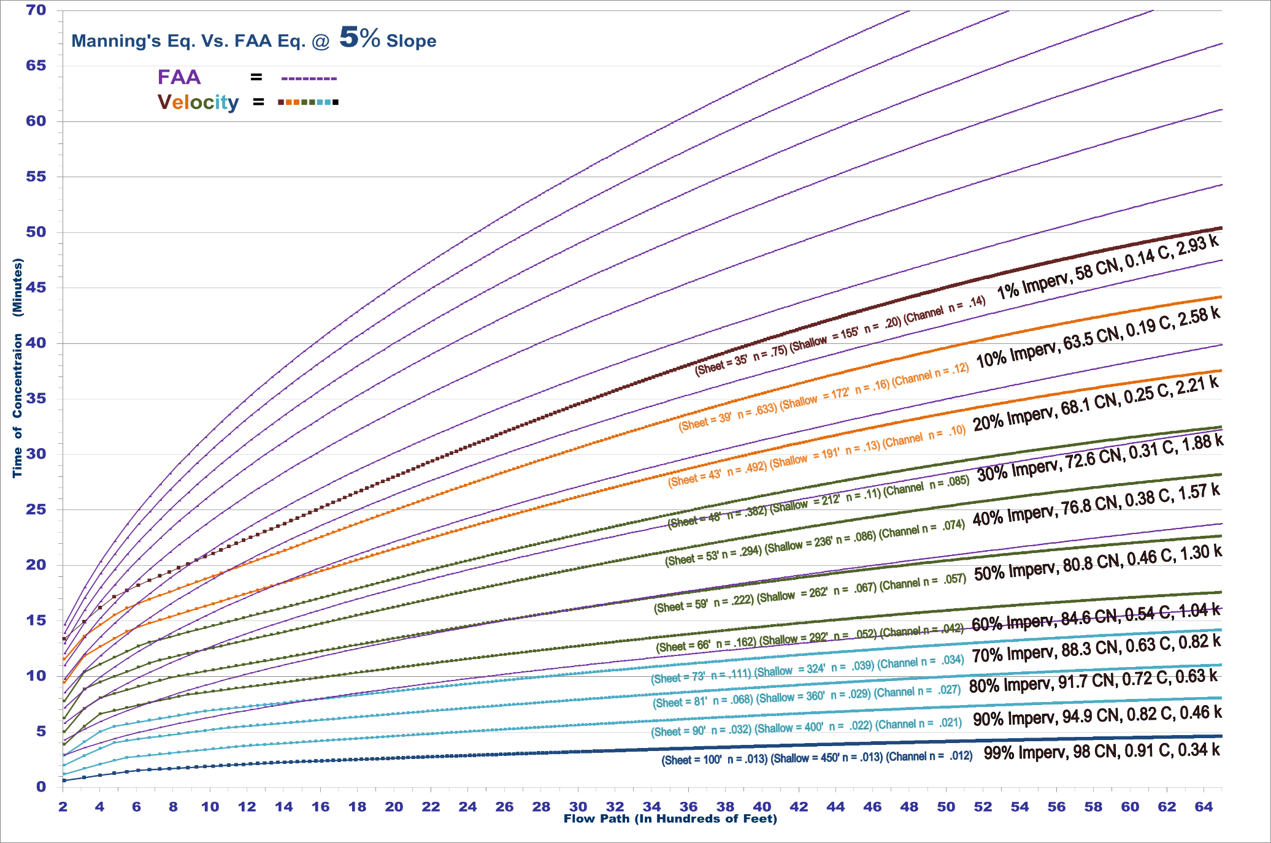
FAA T_{c} vs. Velocity T_{c}’s Compared
No Channelization Factor

Slide 39
Small Watershed Runoff Response
T_{c} comparison graphs between the velocity equations and channelized empirical equations convey a systematic intersect for each related surface coefficient.
Empirical equations provide a lower T_{c} in short flow paths while velocity equations for a same flow path exhibits a higher T_{c}. Empirical equations calculate higher T_{c}’s on longer basin flow paths while velocity equations assess a reduced time for the same longer flow path.
Runoff time on small basins exhibits a transformation from a “surface” attribute flow dominance to a “channel” attribute flow dominance.
TOC - Timing Outside Channel TIC - Timing Inside Channel
Consider a predictable Tc equation for known observations of related Tc equations in multi-surfaced watersheds from recently acquired graphs.

Slide 40
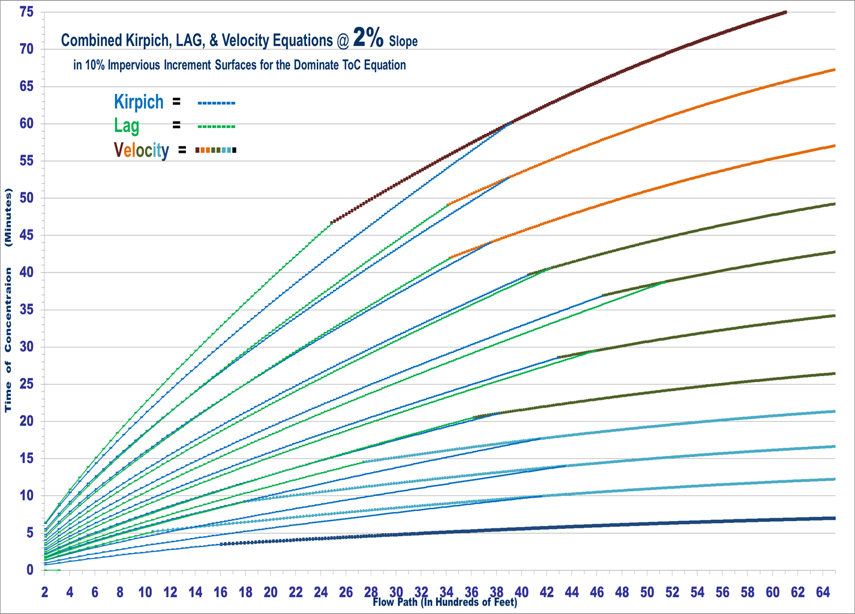
Combined for a 2% Slope Watershed
Dominated by
T I C
Dominated by
T O C

Slide 41
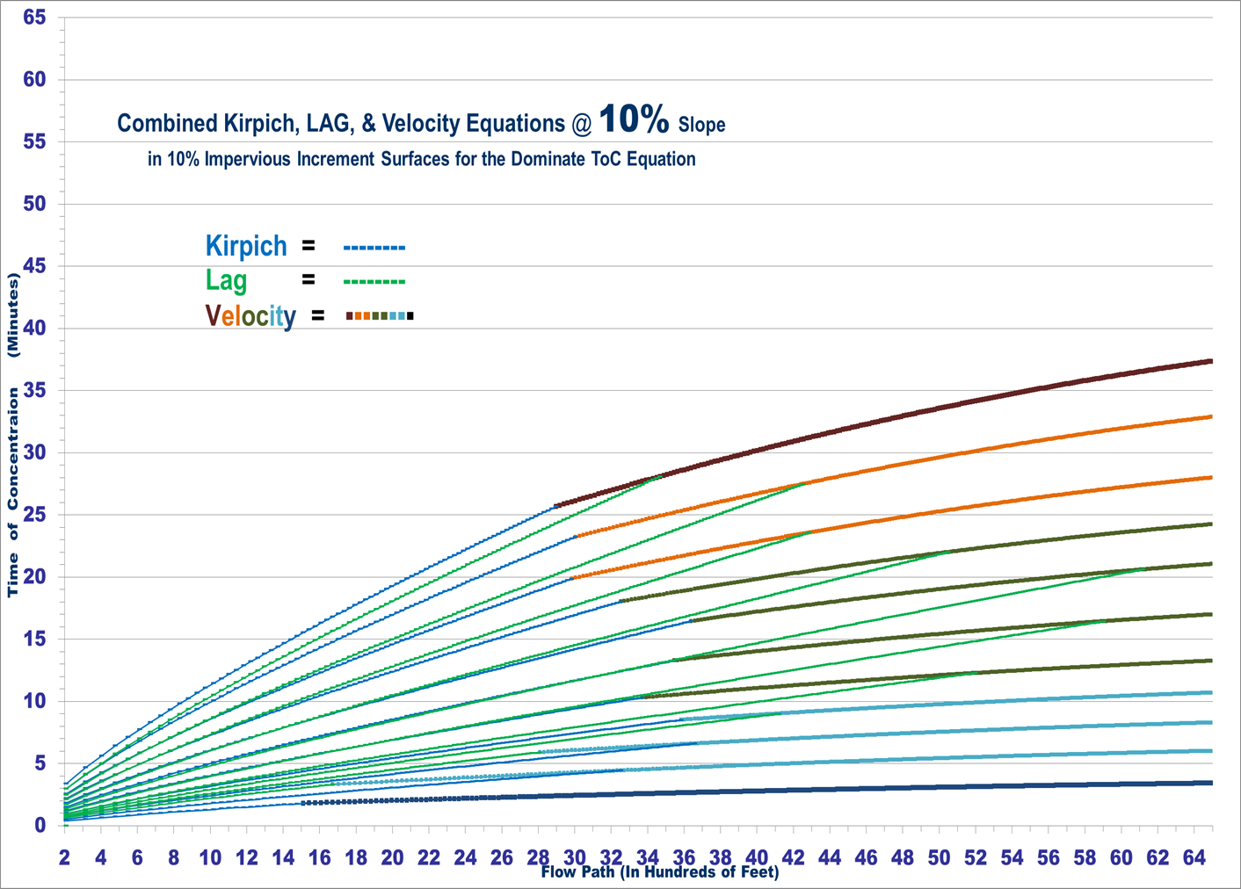
Combined for a 10% Slope Watershed
Dominated by
T I C
Dominated by
T O C

Slide 42
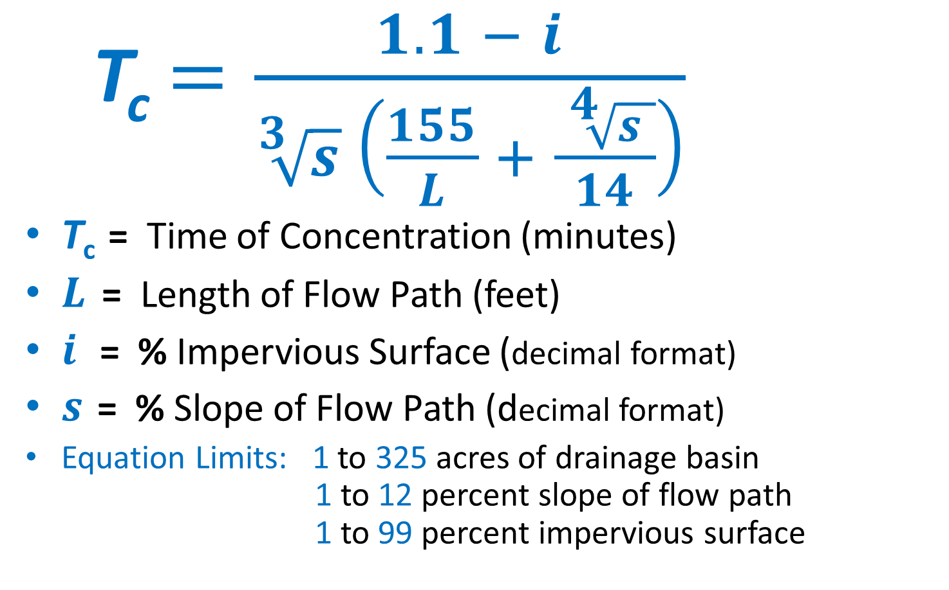
Unified T_{c} Equation with Channelization using % Impervious Surface
  T_{c}$=\frac{1.1 − i}{\sqrt[3]{s} \left(\frac{155}{L} + \frac{ \sqrt[4]{s }}{14}\right)}$
T_{c} = Time of Concentration (minutes)
$L$ = Length of Flow Path (feet)
$i$ = % Impervious Surface (decimal format)
$s$ = % Slope of Flow Path (decimal format)
Equation Limits: 1 to 325 acres of drainage basin 1 to 12 percent slope of flow path 1 to 99 percent impervious surface

Slide 43
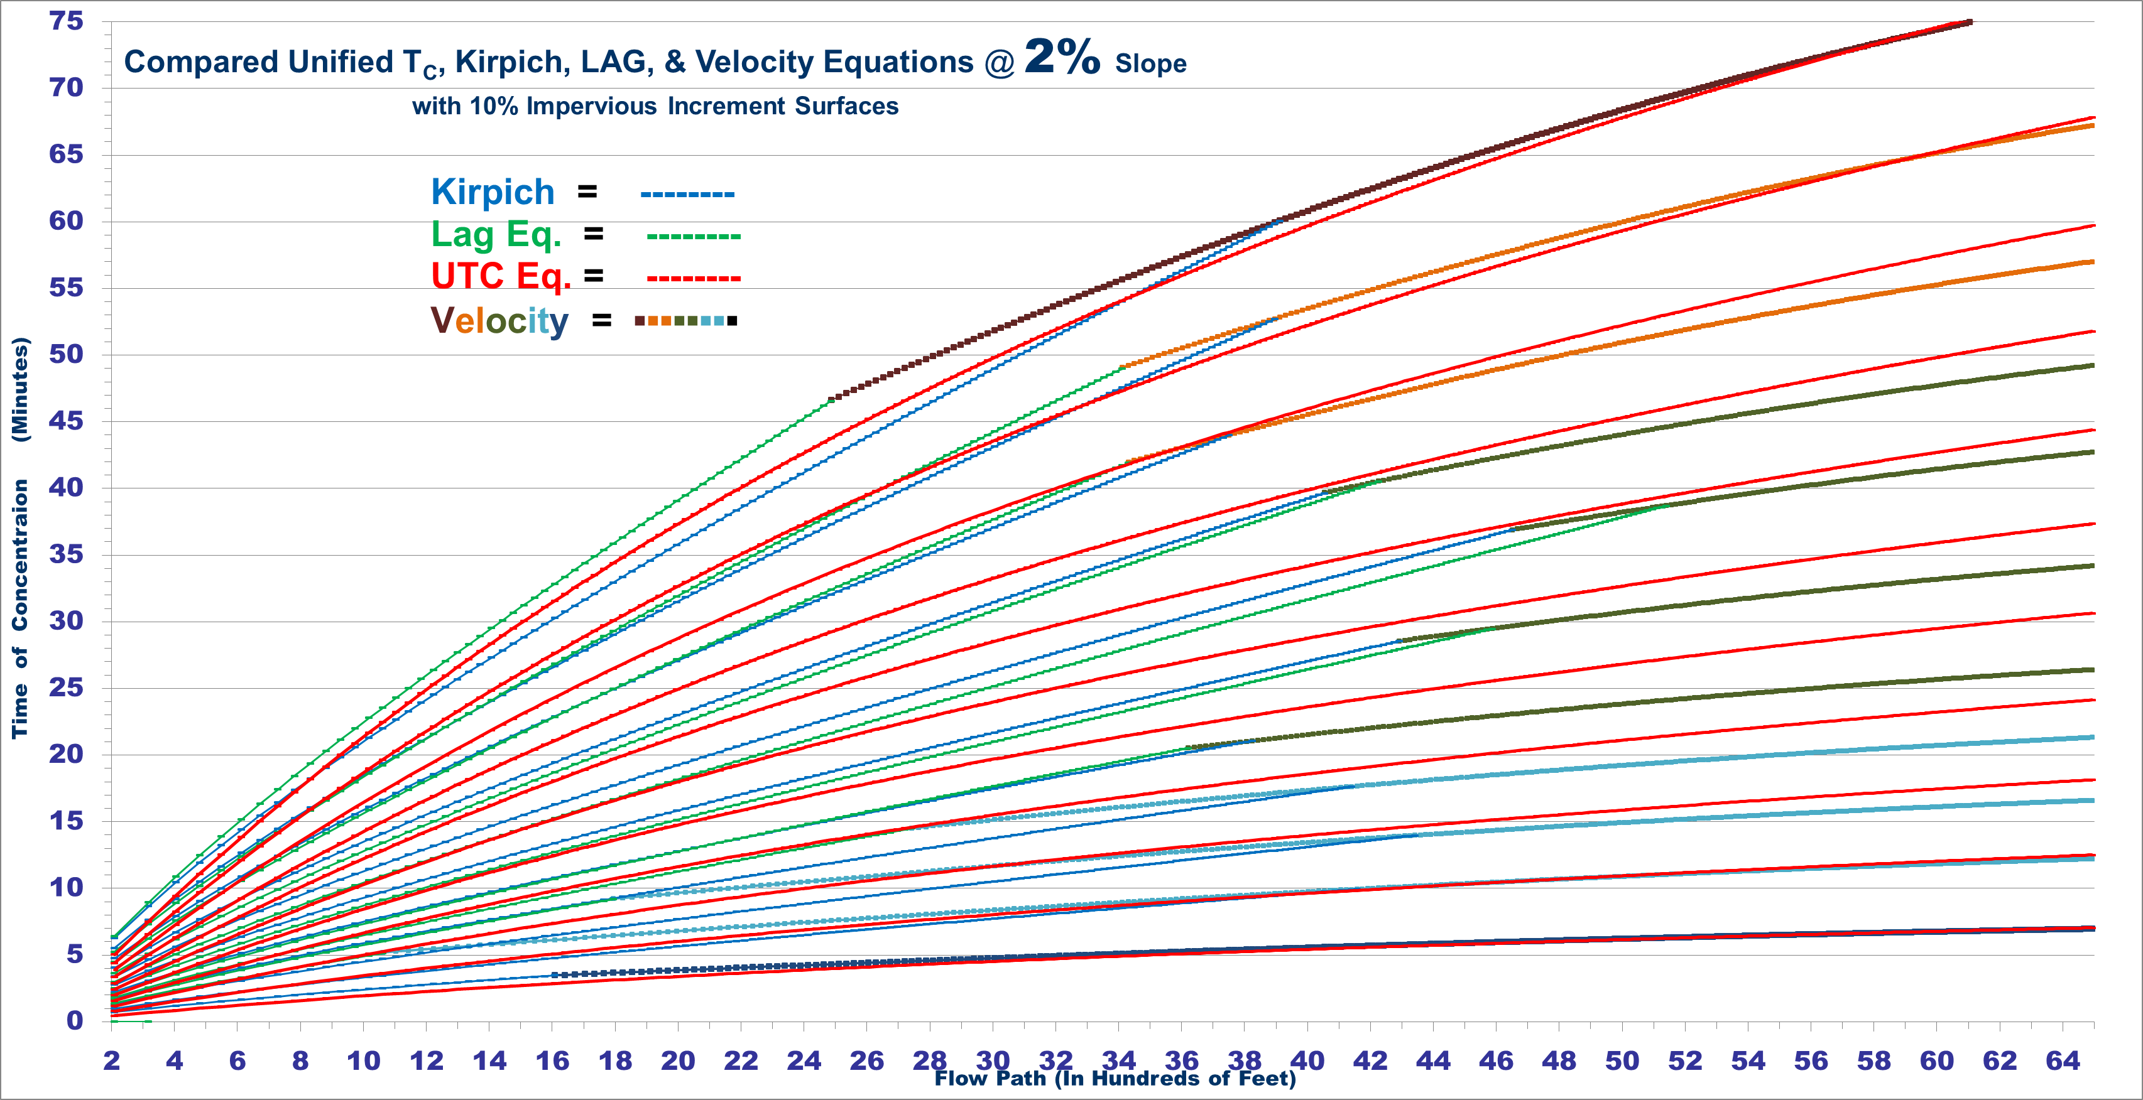
UTC Eq. vs. Lag, Kirpich, & Velocity Curves

Slide 44
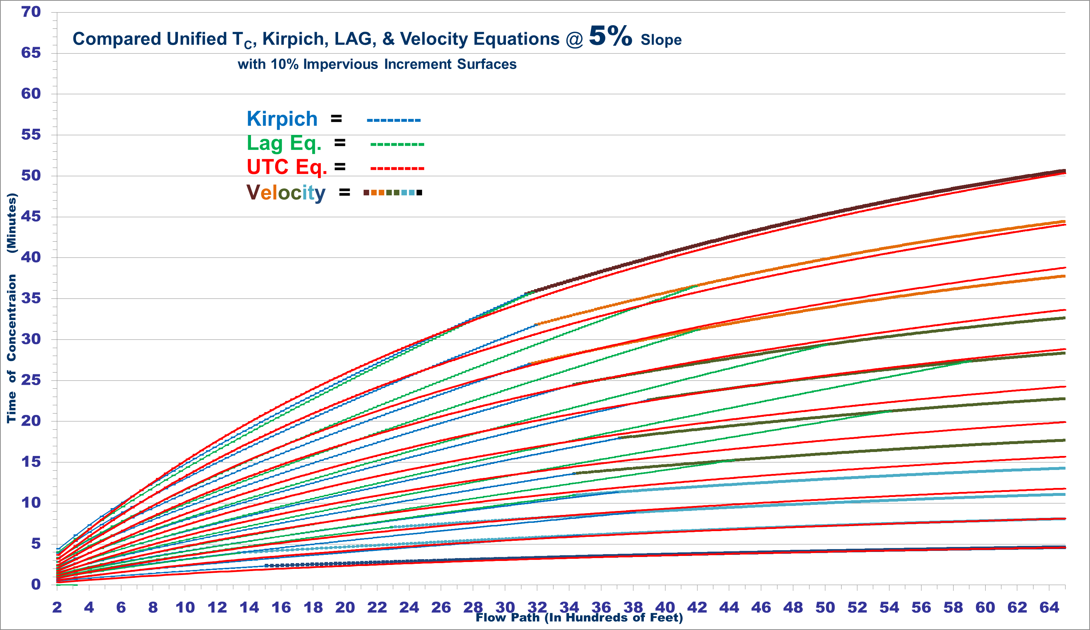
UTC Eq. vs. Lag, Kirpich, & Velocity Curves

Slide 45
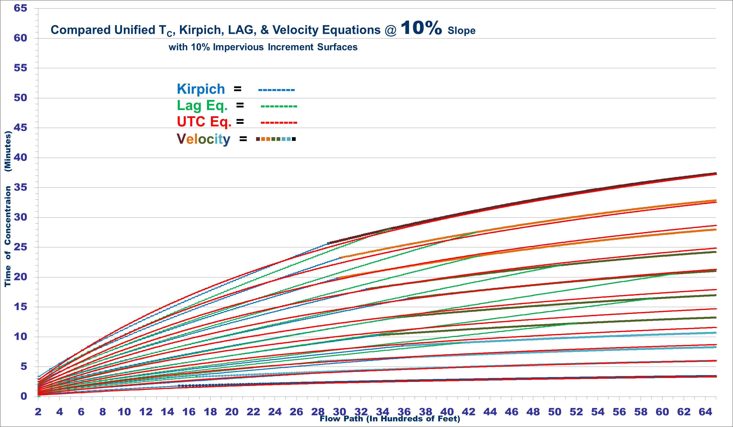
UTC Eq. vs. Lag, Kirpich, & Velocity Curves

Slide 46
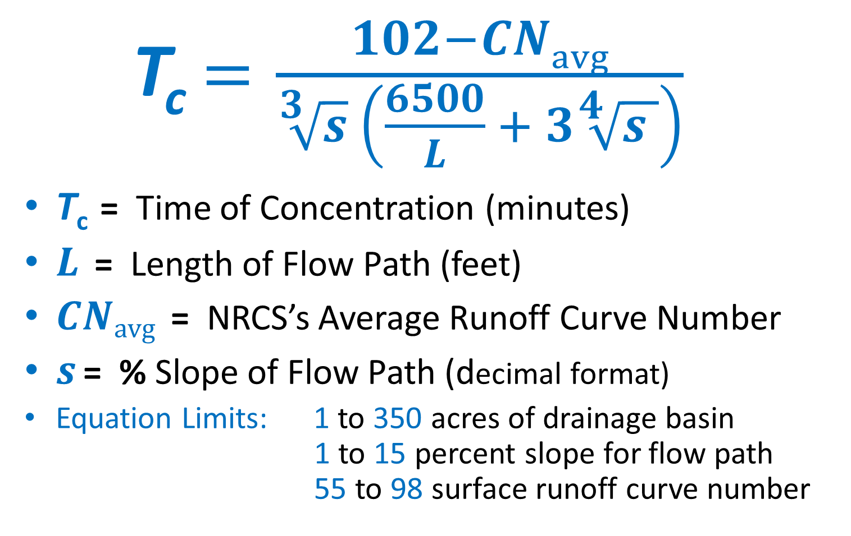
Unified T_{c} Equation with Channelization using CN Values
  T_{c}$=\frac{102−CNavg}{\sqrt[3]{s} \left(\frac{6500}{L} + 3\sqrt[4]{s }\right)}$
T_{c} = Time of Concentration (minutes)
$L$ = Length of Flow Path (feet)
$CNavg$ = NRCS’s Average Runoff Curve Number
$s$ = % Slope of Flow Path (decimal format)
Equation Limits: 1 to 350 acres of drainage basin 1 to 15 percent slope for flow path 55 to 98 surface runoff curve number

Slide 47
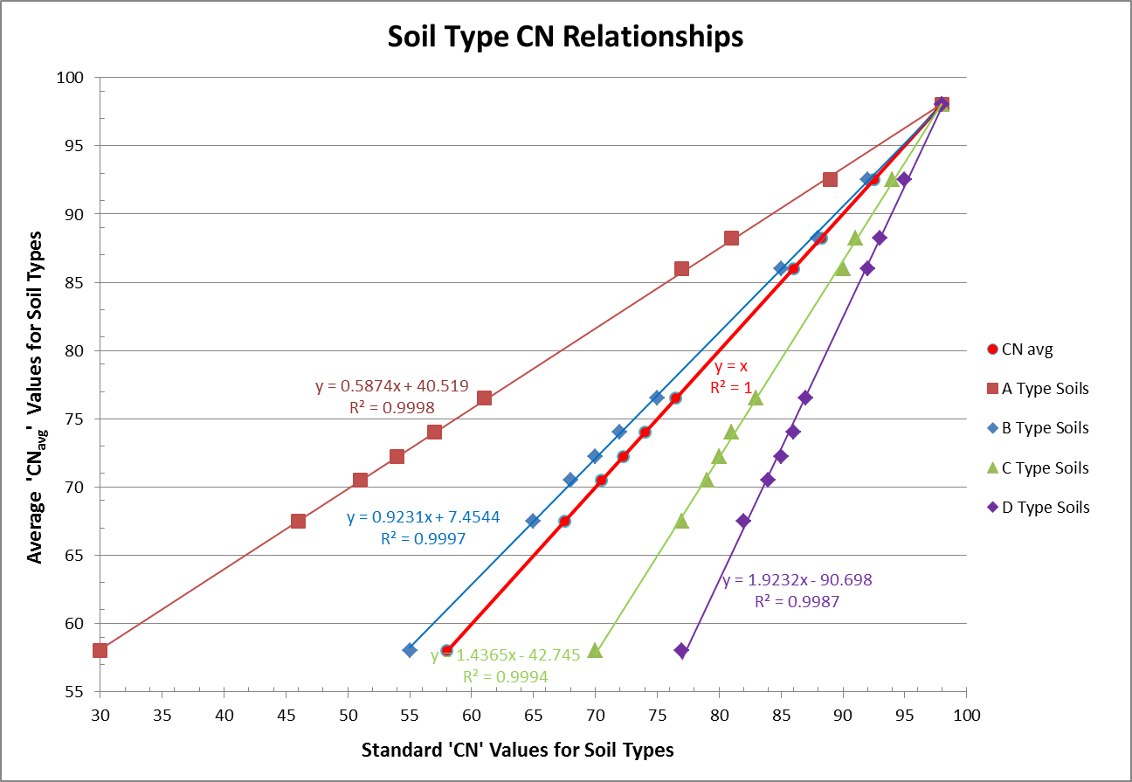
‘CN’ Avg. Relationships for Soil Types

Slide 48
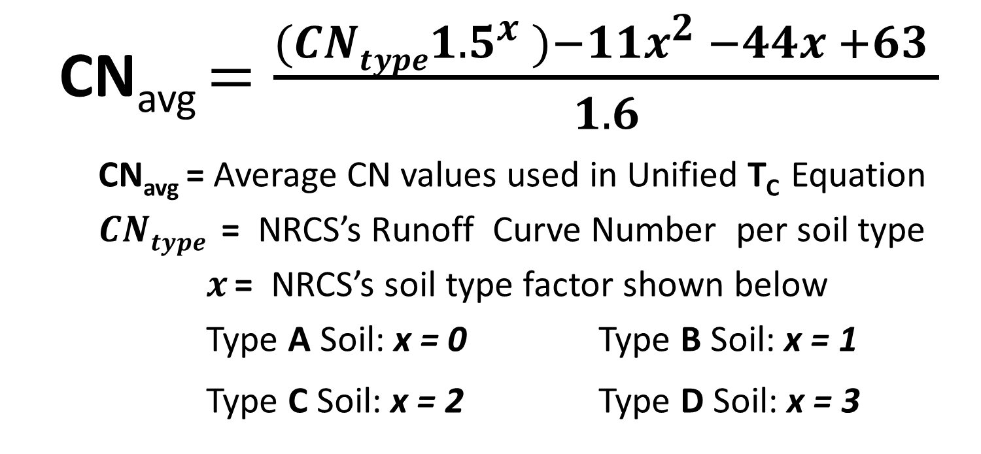
Unified T_{c} Equation uses an average CN
Soil type (near B soil type)
Basin weighed CN value is attained by adjusting CN soil types to a CN_{avg} type
  CN_{avg} $=\frac{({CNtype1.5}^{x} )−11x^{2} −44x +63 }{1.6}$
CN_{avg} = Average CN values used in Unified T_{c} Equation
$CNtype$ = NRCS’s Runoff Curve Number per soil type
$x$ = NRCS’s soil type factor shown below
Type A Soil: x = 0 Type B Soil: x = 1
Type C Soil: x = 2 Type D Soil: x = 3

Slide 49
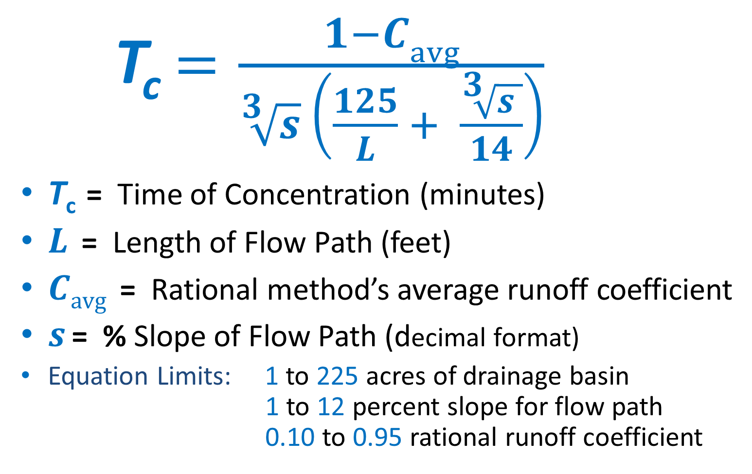
Unified T_{c} Equation for Channelization using ‘C’
  T_{c}$=\frac{1−Cavg}{\sqrt[3]{s} \left(\frac{125}{L} + \frac{\sqrt[3]{s }}{14}\right)}$
T_{c} = Time of Concentration (minutes)
$L$ = Length of Flow Path (feet)
$Cavg$ = Rational method’s average runoff coefficient
$s$ = % Slope of Flow Path (decimal format)
Equation Limits: 1 to 225 acres of drainage basin 1 to 12 percent slope for flow path 0.10 to 0.95 rational runoff coefficient

Slide 50
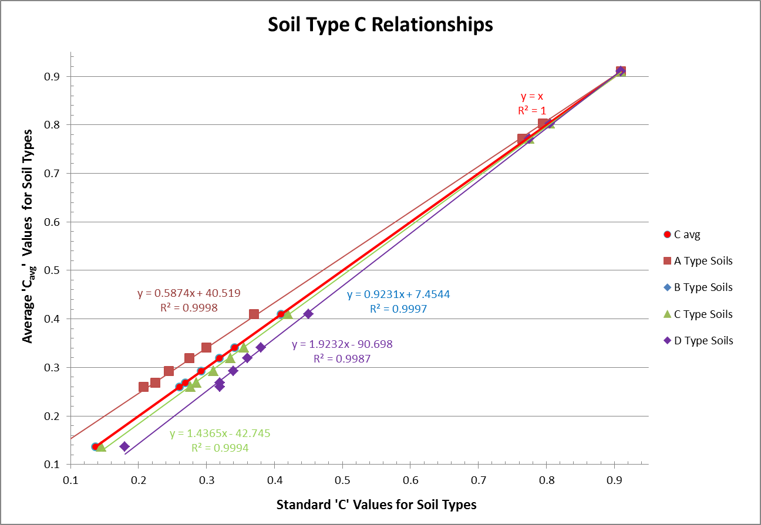
‘C’ Avg. Relationships for Soil Types
using a 10yr. Storm Event

Slide 51
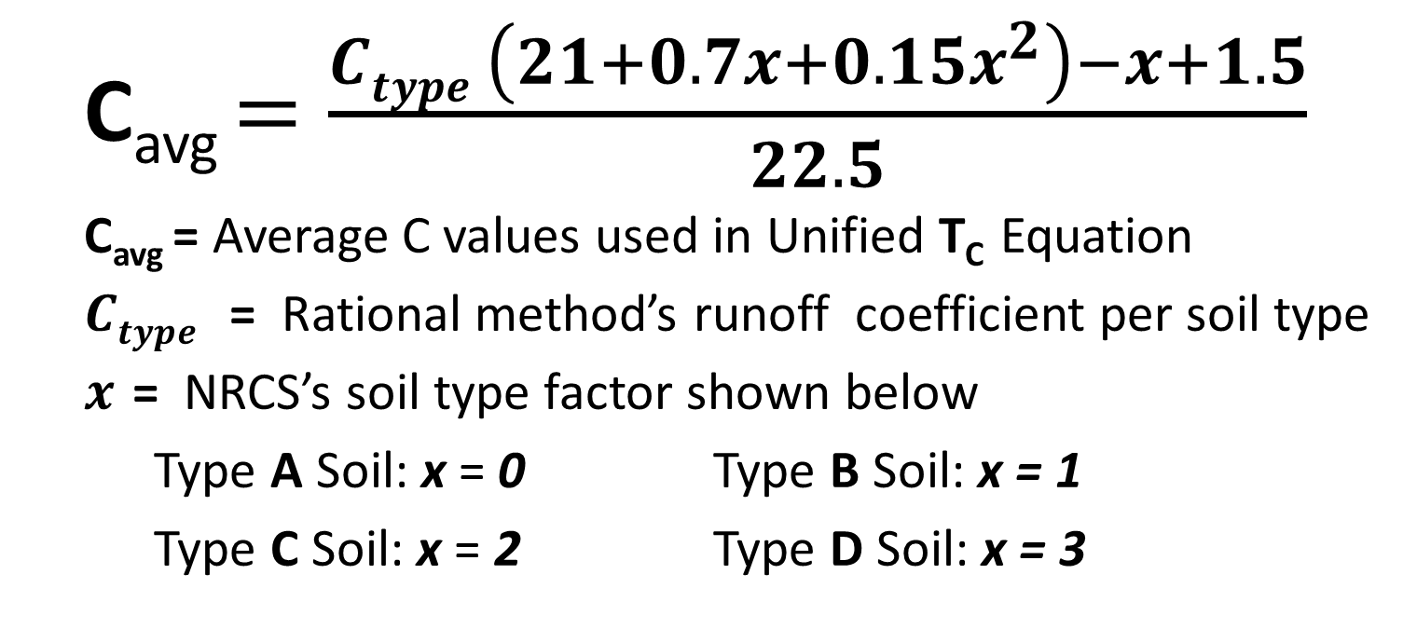
Unified T_{c} Equation uses an average ‘C‘ coefficient (near B soil type)
Basin weighed ‘C’ value is attained by adjusting ‘C’ soil types to a ‘C_{avg}’ type
  C_{avg} $=\frac{Ctype \left(21+0.7x+0.15x^{2}\right)−x+1.5}{22.5}$
  C_{avg} = Average C values used in Unified T_{c} Equation
  $Ctype$ = Rational method’s runoff coefficient per soil type
  $x$ = NRCS’s soil type factor shown below
  Type A Soil: x = 0 Type B Soil: x = 1
  Type C Soil: x = 2 Type D Soil: x = 3

Slide 52
The Iowa Storm Water Management Manual

Slide 53
UDFCD Runoff Coefficients

Slide 54
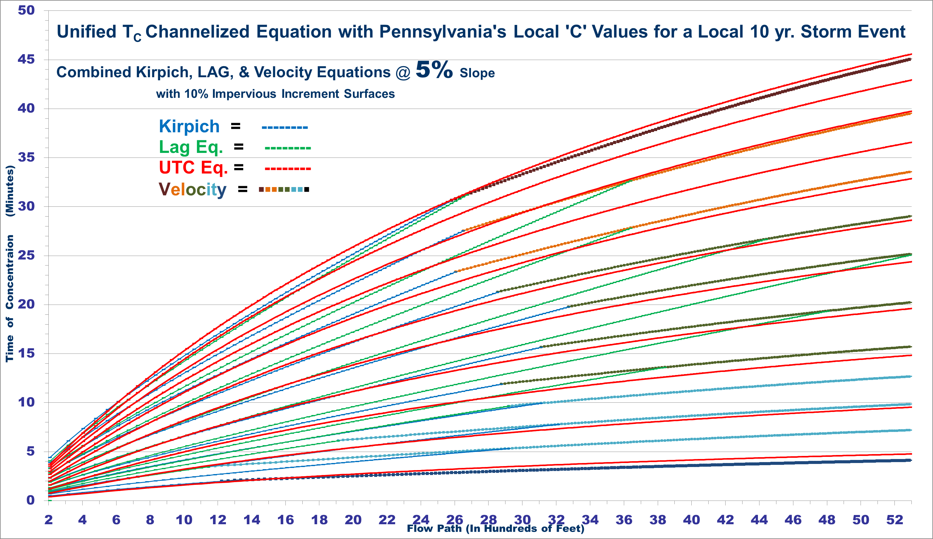
Unified T_{c} C Equation with Pennsylvania’s local ‘C’ Value for a Local 10 yr. Event

Slide 55
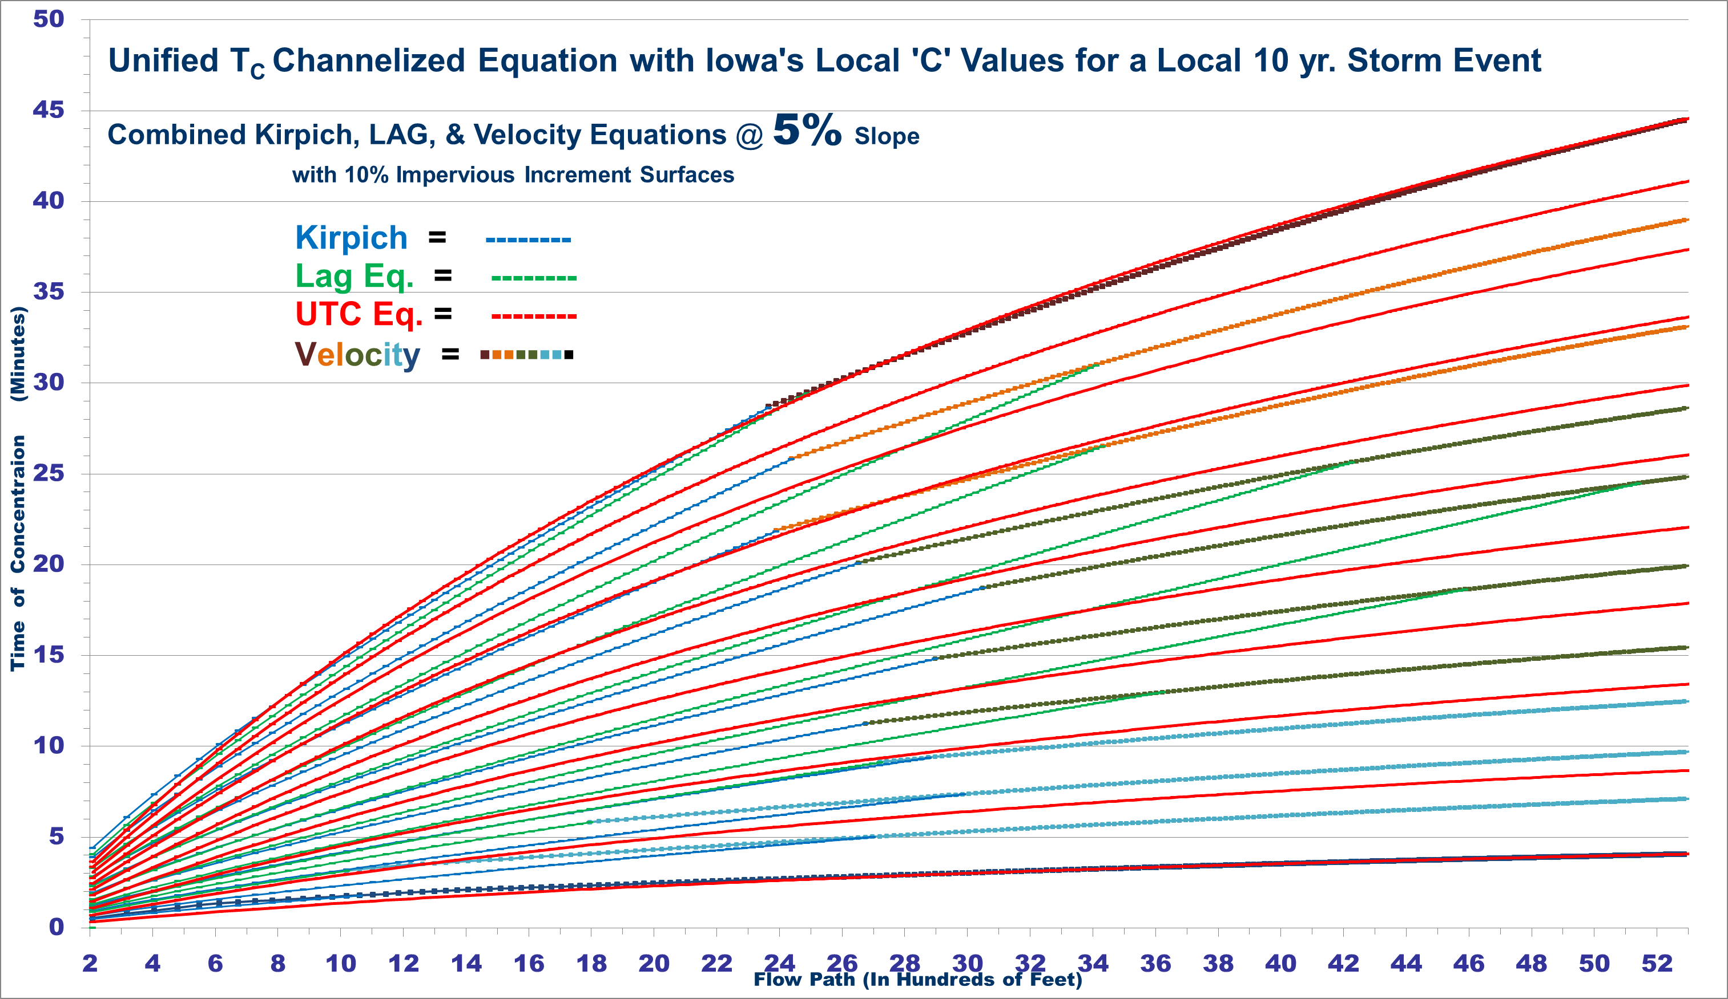
Unified T_{c} ‘C’ Equation with Iowa’s local ‘C’ values for a 10 yr. Event

Slide 56

Unified T_{c} ‘C’ Equation with Colorado’s Local ‘C’ values for a Local 10 yr. Storm

Slide 57
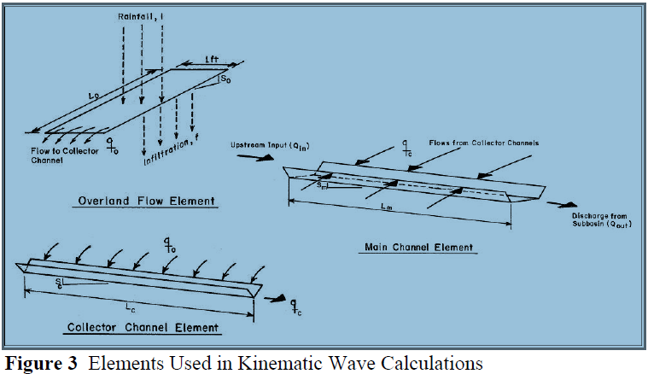
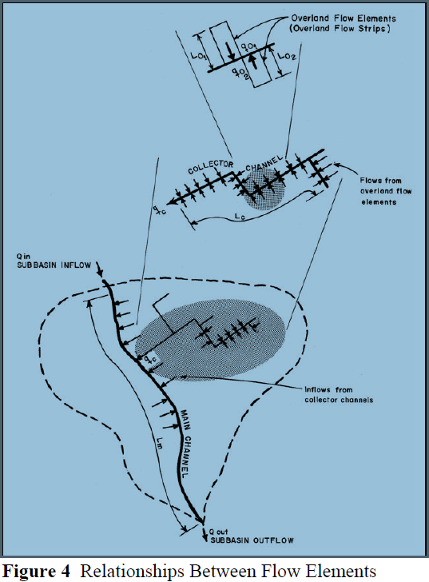
Kinematic Wave Theory is Significant in Prevailing Hydrology Flow Equations
Kinematic wave method relates flows to the basin characteristics.
Kinematic basin routing parameters define the channel shape, boundary roughness, and slope of the flow routing surface.
Flood runoff waves are defined by two studies of motion kinematic and dynamic (changes in discharge, velocity, & surface elevations) wave equations.
Kinematic wave equations govern flow with forces essentially from flow of fluid weight balanced by surface resistive forces.
Kinematic wave approximation is an accurate & efficient method of modeling storm water runoff for both overland flow & channel routing. (Overton & Meadows, 1976)

Slide 58

Papadakis-Kazan T_{c} Equation
      ${ T}_{c}=\frac{k {(L)}^{a} {(n)}^{b}}{{(i)}^{z } {(S)}^{y}}$ $T_{c}=\frac{0.66 {(L)}^{0.5} {(n)}^{0.52}}{{(i)}^{0.38 } {(S)}^{0.31}}$
      A global regression equation derived from eleven T_{c} equations
T_{c} = minutes, L = flow path length (ft.)
n = Manning’s Coefficient, S = flow path slope in (ft./ft.)
i = Rainfall Intensity (in./hr.), k = Constant
Developed from frequent T_{c} equations that includes Kirpich, Izzard, Kerby/Hathaway, Carter, Eagleson, Kinematic Wave, Morgali, Linsley, FAA, SCS Velocity , SCS Curve (Lag), and Singh’s Kinematic Wave/Chezy equations.
Examination of existing equations used for time of concentration revealed a shared a general format. The resulting upper right equation right provides an general applicable Tc equation with a predetermined degree of confidence.
The common exponents a, b, y, z, and the constant k for the 4 variables were formed from 375 data points on natural and experimental watersheds of less than 500 acres. A regression analysis was performed for each with a best fit.

Slide 59



Papadakis-Kazan T_{c} with Manning's Channel ‘n’ Value Compared to Velocity & UTC Equations
Percent Impervious | ‘n’ Sheet Coefficients | ‘n’ Shallow Coefficients | ‘n’ Channel Coefficients
1% | 0.750 | 0.200 | 0.140
10% | 0.655 | 0.160 | 0.120
20% | 0.511 | 0.130 | 0.100
30% | 0.395 | 0.110 | 0.085
40% | 0.302 | 0.086 | 0.074
50% | 0.225 | 0.067 | 0.057
60% | 0.161 | 0.052 | 0.042
70% | 0.106 | 0.039 | 0.034
80% | 0.060 | 0.029 | 0.027
90% | 0.021 | 0.022 | 0.021
99% | 0.013 | 0.013 | 0.012

Slide 60



Papadakis-Kazan T_{c} with Manning’s Shallow ‘n’ Value Compared to Velocity & UTC Equations
Percent Impervious | ‘n’ Sheet Coefficients | ‘n’ Shallow Coefficients | ‘n’ Channel Coefficients
1% | 0.750 | 0.200 | 0.140
10% | 0.655 | 0.160 | 0.120
20% | 0.511 | 0.130 | 0.100
30% | 0.395 | 0.110 | 0.085
40% | 0.302 | 0.086 | 0.074
50% | 0.225 | 0.067 | 0.057
60% | 0.161 | 0.052 | 0.042
70% | 0.106 | 0.039 | 0.034
80% | 0.060 | 0.029 | 0.027
90% | 0.021 | 0.022 | 0.021
99% | 0.013 | 0.013 | 0.012

Slide 61



Papadakis-Kazan T_{c} with Manning’s Sheet ‘n’ Value Compared to Velocity & UTC Equations
Percent Impervious | ‘n’ Sheet Coefficients | ‘n’ Shallow Coefficients | ‘n’ Channel Coefficients
1% | 0.750 | 0.200 | 0.140
10% | 0.655 | 0.160 | 0.120
20% | 0.511 | 0.130 | 0.100
30% | 0.395 | 0.110 | 0.085
40% | 0.302 | 0.086 | 0.074
50% | 0.225 | 0.067 | 0.057
60% | 0.161 | 0.052 | 0.042
70% | 0.106 | 0.039 | 0.034
80% | 0.060 | 0.029 | 0.027
90% | 0.021 | 0.022 | 0.021
99% | 0.013 | 0.013 | 0.012

Slide 62


Mathematical Boundaries of Variables in the UTC, Kinematic Wave Flow, and Papadakis-Kazan Equations
UTC Eq. plotted for Impervious Surface Boundary
UTC Eq. plotted Surface Boundary of NRCS CN Values
Surface Boundary Coefficient’s have Hydrologic Value Limits by Hydrology Definitions. However, These Limits May Not Exist within a Mathematic Equation.

Slide 63


Mathematical Boundaries of Variables in the UTC, Kinematic Wave Flow, and Papadakis-Kazan Equations
Kinematic Equations plotted for Surface Boundary of Manning’s ‘n’ Value
Papadakis-Kazan Equation plotted for Surface Boundary of Manning’s ‘n’ Value
Surface Boundary Coefficient’s ‘n’ at the Vertical Axis can be Estimated with a Range of Limits for ‘s’ and ‘i’ for the Entire Limits of the Mathematic Equation.

Slide 64






An Evaluation of the Papadakis-Kazan T_{c} Equation for a Full Range of Manning's Sheet Flow ‘n’ Values
Papadakis-Kazan Equation Arranged for Rainfall Intensity
Partial Multi-Variable Derivative of Papadakis-Kazan Eq. with respect to ‘L’
Papadakis-Kazan
‘i’ Optimized for Manning’s Sheet Flow ‘n’ Values
=

Slide 65

Papadakis-Kazan T_{c} Compared to Velocity & UTC Eqs.

Slide 66

Papadakis-Kazan T_{c} Compared to Velocity & UTC Eqs.

Slide 67

Papadakis-Kazan T_{c} Compared to Velocity & UTC Eqs.

Slide 68


Papadakis-Kazan T_{c} Equation for Surface Boundary Conditions with Manning’s ‘n’ Sheet Flow Coefficients
Percent Impervious | ‘n’ Sheet Coefficients
1% | 0.750
10% | 0.655
20% | 0.511
30% | 0.395
40% | 0.302
50% | 0.225
60% | 0.161
70% | 0.106
80% | 0.060
90% | 0.021
99% | 0.013
. Papadakis-Kazan with surface and channelization attributes
T_{c} = Time of Concentration (minutes)
$L$ = Length of Flow Path (feet)
n $avg$ = Manning’s Sheet Flow Coefficient
$s$ = % Slope of Flow Path (decimal format)
Equation Limits: 1 to 500 acres of drainage basin 1 to 12 percent slope for flow path 0.013 to 0.75 Manning’s sheet surface ‘n’ value

Slide 69

The Complexities of a T_{c} Equation when Properly Applied to a Basin’s Attributes Can Reasonably Estimate a Response Time for Storm Water Runoff
Time of Concentration is Vital to Hydrograph Peak Flow Assessment And a Reasonably Estimated T_{c} can Vary Peak Flows by 300%.
$±$
The Accuracy of Time Equations are Improved with the following:
Understanding the required variables in a time of concentration equation.
Understanding the limits to each variable in a time of concentration equation.
Understanding a basin’s flow path with its flow type, length, depth, and slope.
Apply acceptable surface roughness T_{c} coefficients that correlate to equivalent hydrology’s surface roughness conditions used to calculate the hydrograph.
Ken Kagy, P.E., CFM, CPSWQ, CPESC (770) 343-8365 kenkagy@yahoo.com

